Slide 1
Grass Fed Beef Genetics & Finishing
Allen R Williams, Ph.D.
Grass Fed Insights, LLC

Slide 2
Selecting Grass-Based Genetics

Slide 3
Selection Basics
Number 1 Trait = Longevity
Adaptability
Fertility
Soundness
Moderate Frame
Easy Fleshing
Proper Phenotype

Slide 4
Bull Phenotype

Slide 5
Thick Muscled Bull with Expressive Lower Mid-Rib

Slide 6
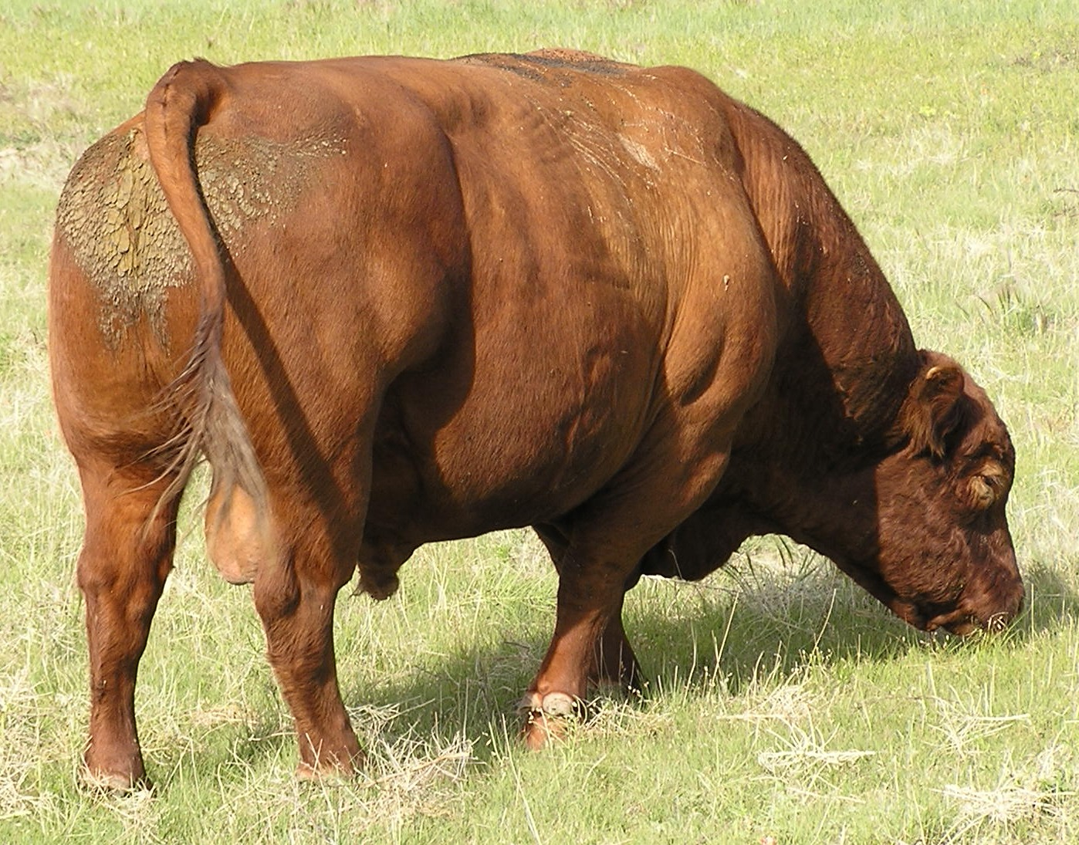
Excellent Phenotype Bull in His Working Clothes

Slide 7
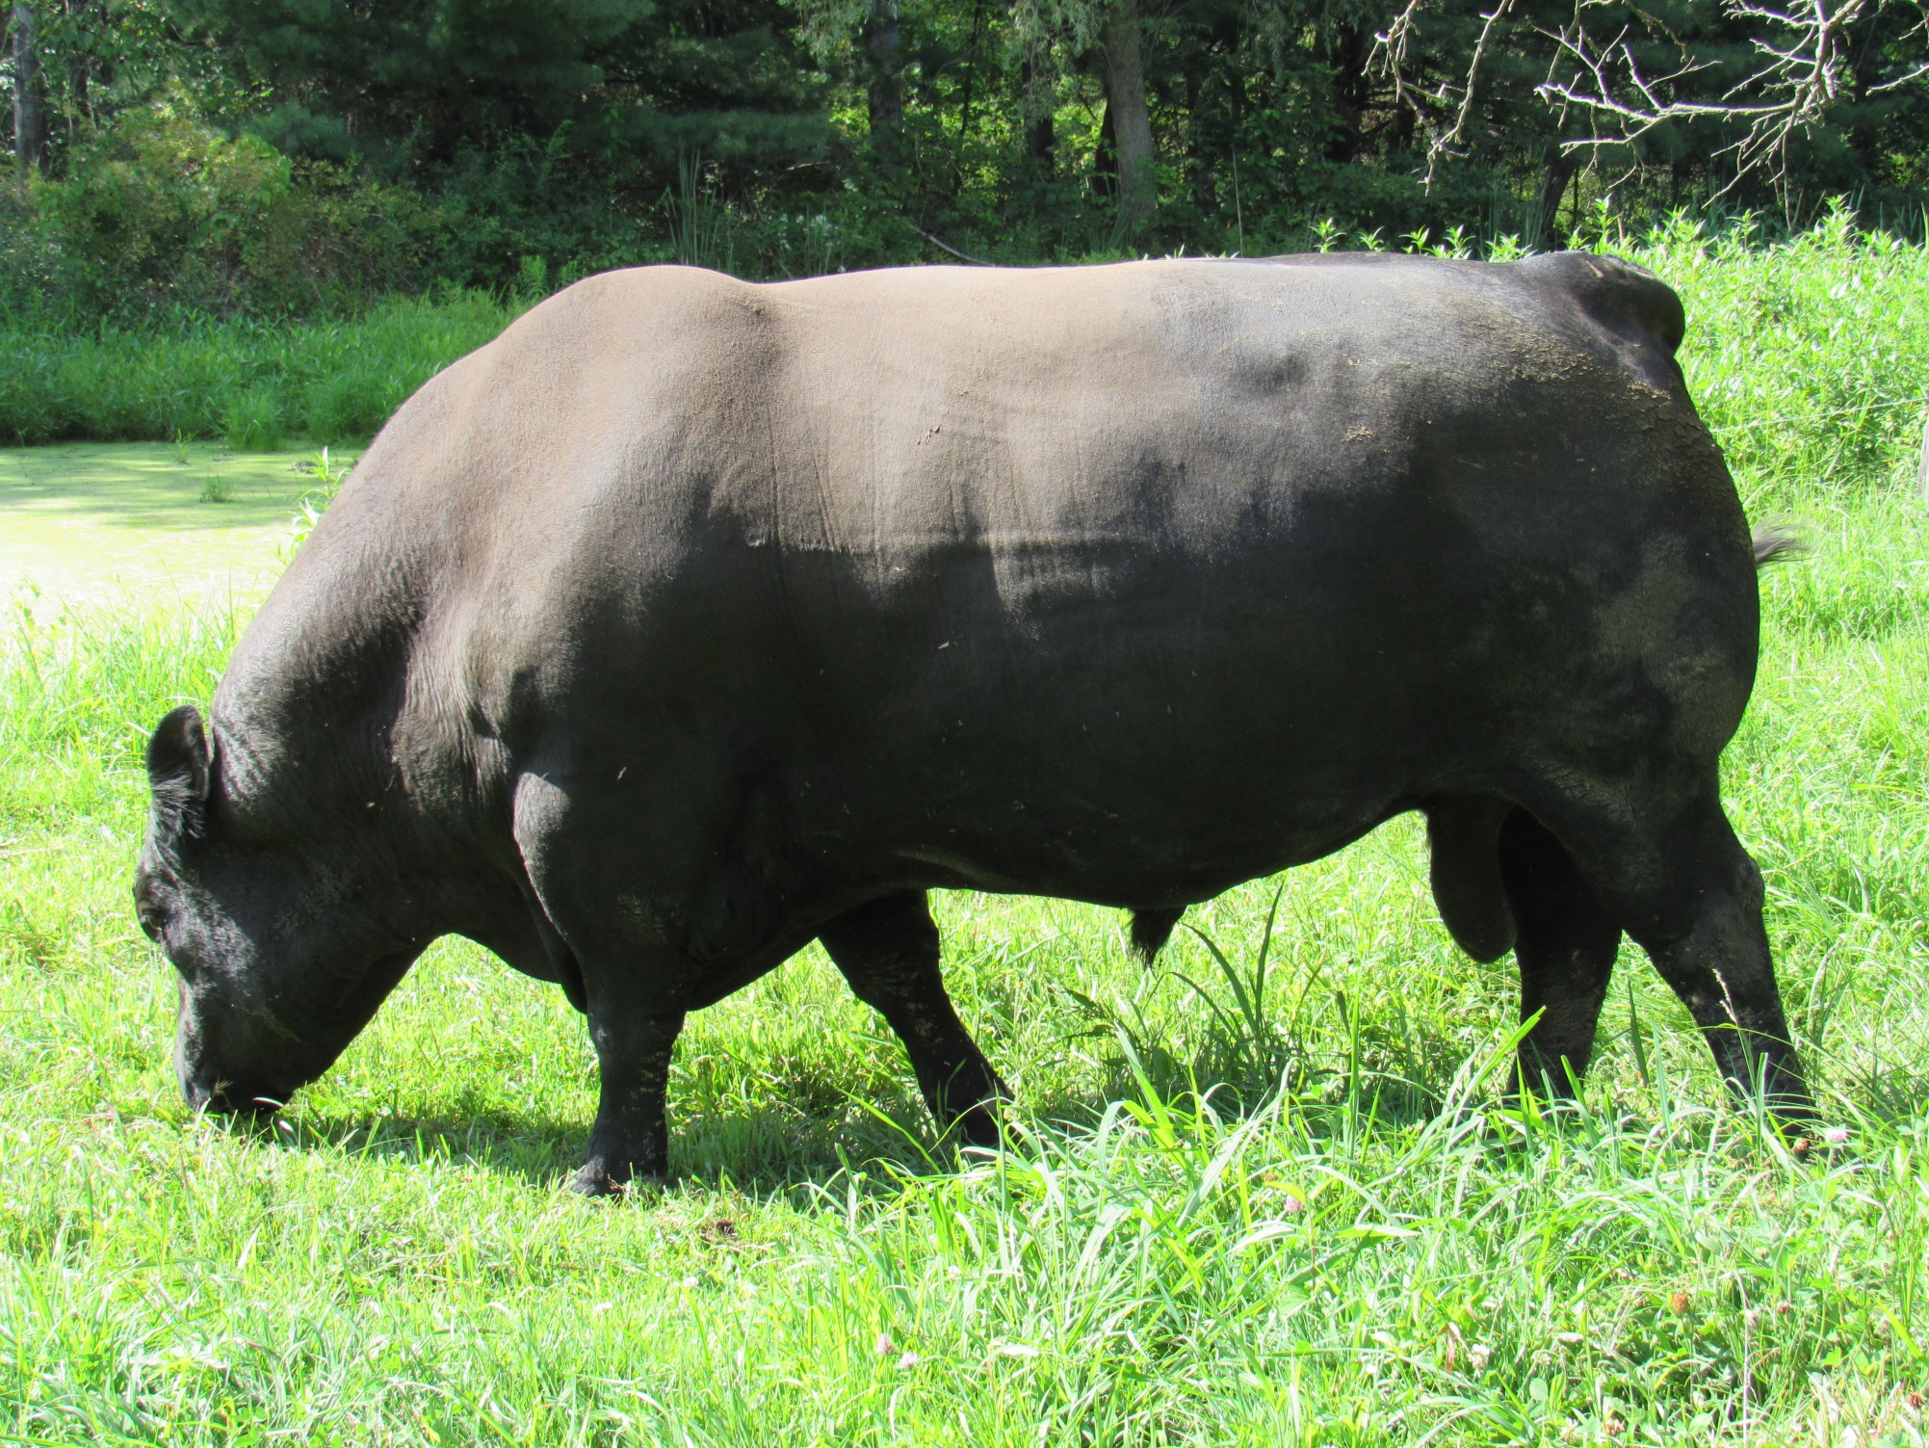

Slide 8
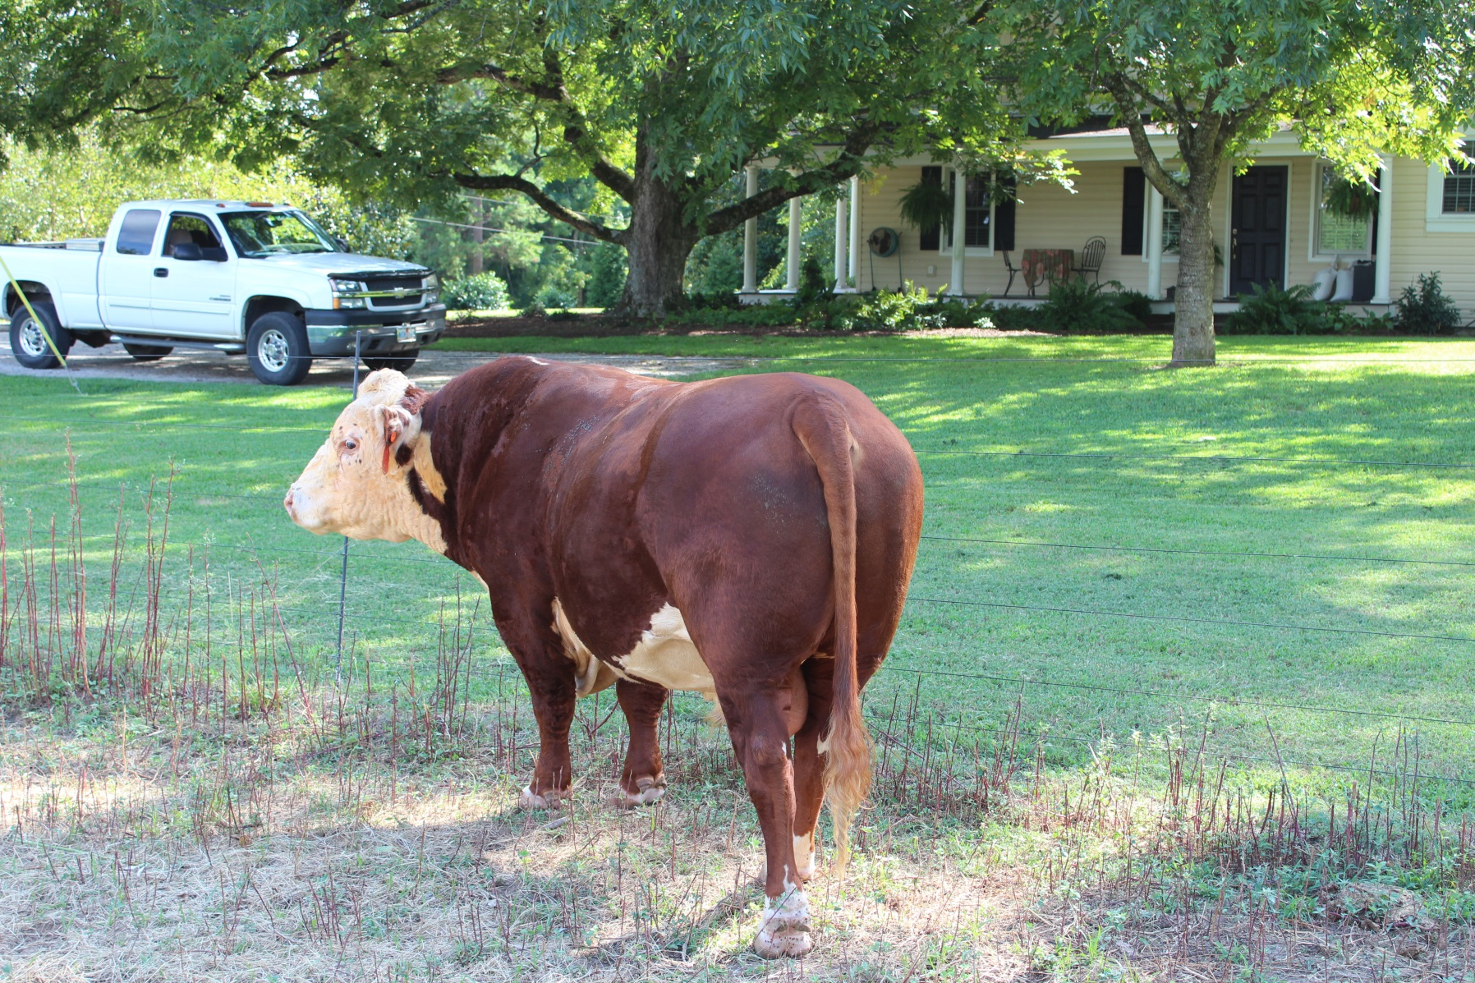

Slide 10
Cow Phenotype

Slide 11
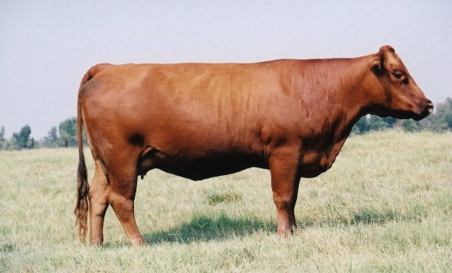
Cow Selection

Slide 12
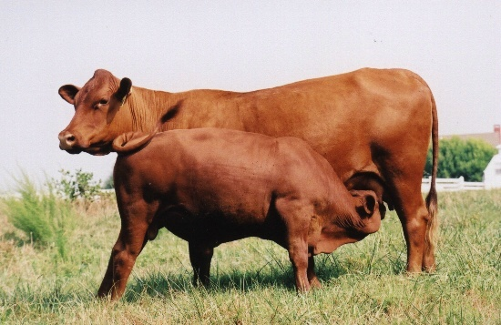
What Should Cows Look Like?
Sound Feet, Legs
Sound Udder, Teats
Feminine
Easy Fleshing

Slide 13
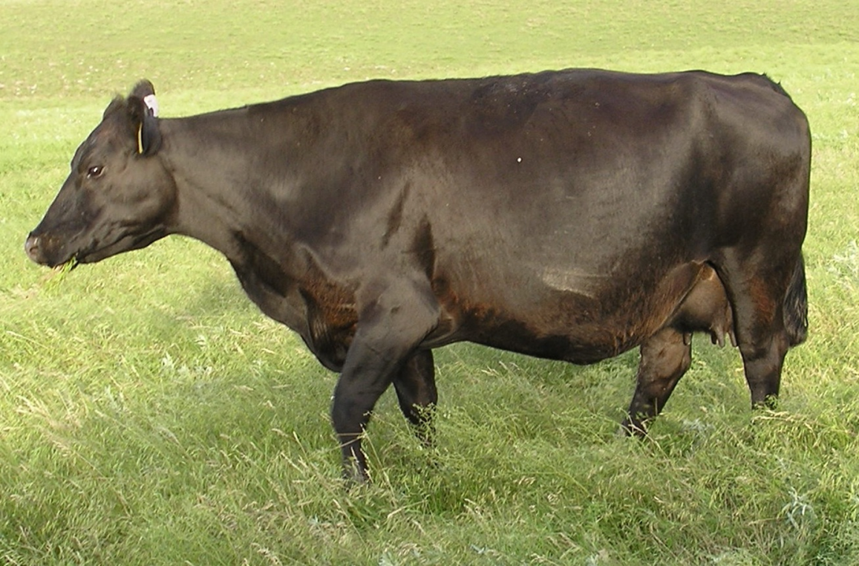
DAIRY
BEEF

Slide 14
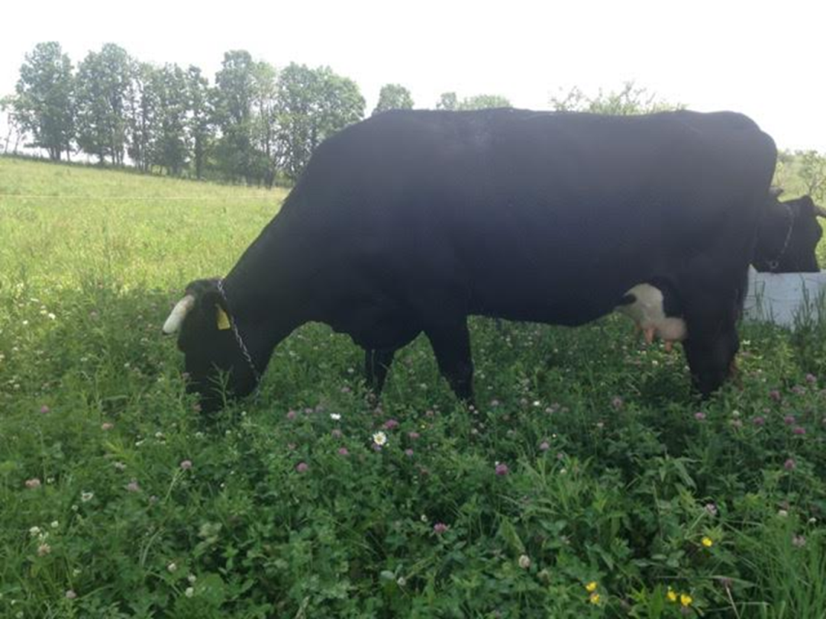
BEEF
DAIRY

Slide 15
FINISHING
Keys to Optimal Finishing:
Soil Health!!
Genetics!!!
Forage & Grazing Management
Plant species diversity & complexity
Forage DM & Nutritive Value - Brix
Seasonal Impacts/affects
Annuals & Perennials
Filling the gaps - Supplementation

Slide 16
BRIX
Higher Brix – Result of improving SOM and soil microbial populations.

Slide 17
BRIX
Dissolved plant solids include sugars (such a sucrose and fructans), minerals, amino acids, proteins, lipids and pectins.
Higher Brix – Result of improving SOM and soil microbial populations.

Slide 18
Simple To Measure
Can use either Optical or Digital Refractometer.
Digital
Optical

Slide 19
Measuring Brix – Sample Prep

Slide 20
Measuring Brix - Refractometer

Slide 21
Why High Brix in Forages?
Research shows
increase animal gains
Increase Milk/components
High Brix Forages are:
More drought resistant
Freeze tolerant,
More resistant to plant disease and pests
References:
(Moorby, 2001).
(Moller, 1996).
(Downing & Gamroth, 2007; Miller, et al, 1999).
(Allison, 2007).
(McKenzie, 2007).

Slide 22
Brix Advantage
Brix 5.0% or less = ADG in low 1’s.
Brix 8-12% = ADG in low to mid-2’s.
Brix 12 – 15% = ADG in mid-high 2’s.
Brix > 15% = ADG in high 2’s to 3’s.
Every 1.0% increase in Brix adds 0.1 to 0.3 ADG.
Going from 3% to 6% Brix in dairy pastures adds between 10-20% milk production.

Slide 23
Impact of forage quality on ADG

Slide 24
Single Season Forage Brix Impact: AMP Grazing Vs. Conventional Grazing
Plant Brix (%)
Field Trial Location By State

Slide 25
Effects of Stage of Maturity on Pasture Composition
7
33
Protein
3
Lipid
25
10
Sugars
10
5
Minerals
23
12
Hemicellulose
14
30
Cellulose
18
3 Lignin 7
Early Maturity
Mid Maturity
Late Maturity

Slide 26
Effects of Stage of Maturity on Pasture Composition
7
33
Protein
3
Lipid
25
10
Sugars
10
5
Minerals
Sweet Spot
23
12
Hemicellulose
14
30
Cellulose
18
3 Lignin 7
Early Maturity
Mid Maturity
Late Maturity

Slide 27
Too Big to Ignore
Two Keys to Better Gains:
Stage of maturity of forage when grazed
Timing of daily moves
Paying attention will result in ADG improvements of 0.25 to 0.5 lbs/hd/day.

Slide 28
Important Grazing Tips
Know DM availability and allow 3.0% - 3.5% DM per head daily.
Take no more than 30%- 50% available DM in a single grazing.
Move forward rapidly to not allow too many bites of the same plant.
Know the brix content.
Turn into new paddocks in early to mid-afternoon (peak brix or plant sugars).
Stage of forage maturity critical – Mid-stage to slightly beyond…

Slide 29
What is a “Finished” Animal?

Slide 30
Where to Look for Proper Degree of Finish
Tailhead
Topline
Ribs
Brisket
Flank
Heart Girth

Slide 31
Fat Deposit in the Brisket Is a Good Sign of Degree of Finish
Brisket

Slide 32
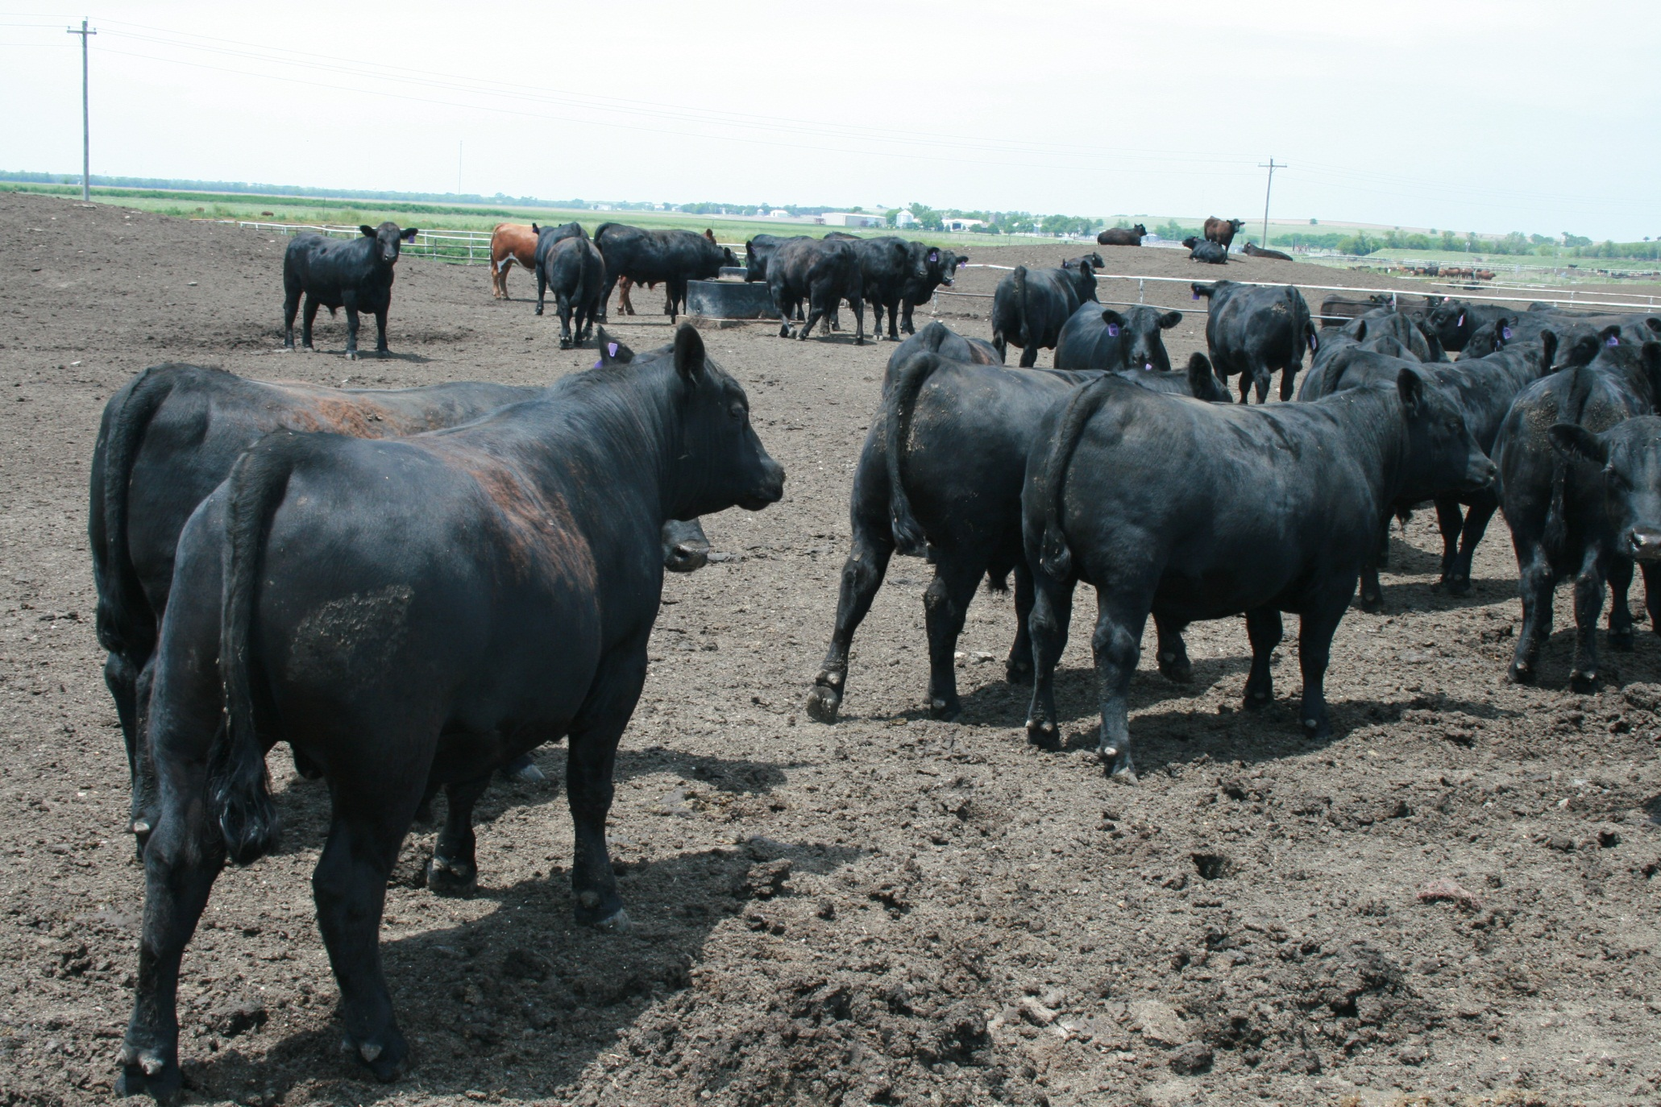
Heavy Pones of Fat Around the Tailhead Are signs of a Well Finished Animal
Fat Pones

Slide 33
What is the Target?

Slide 34
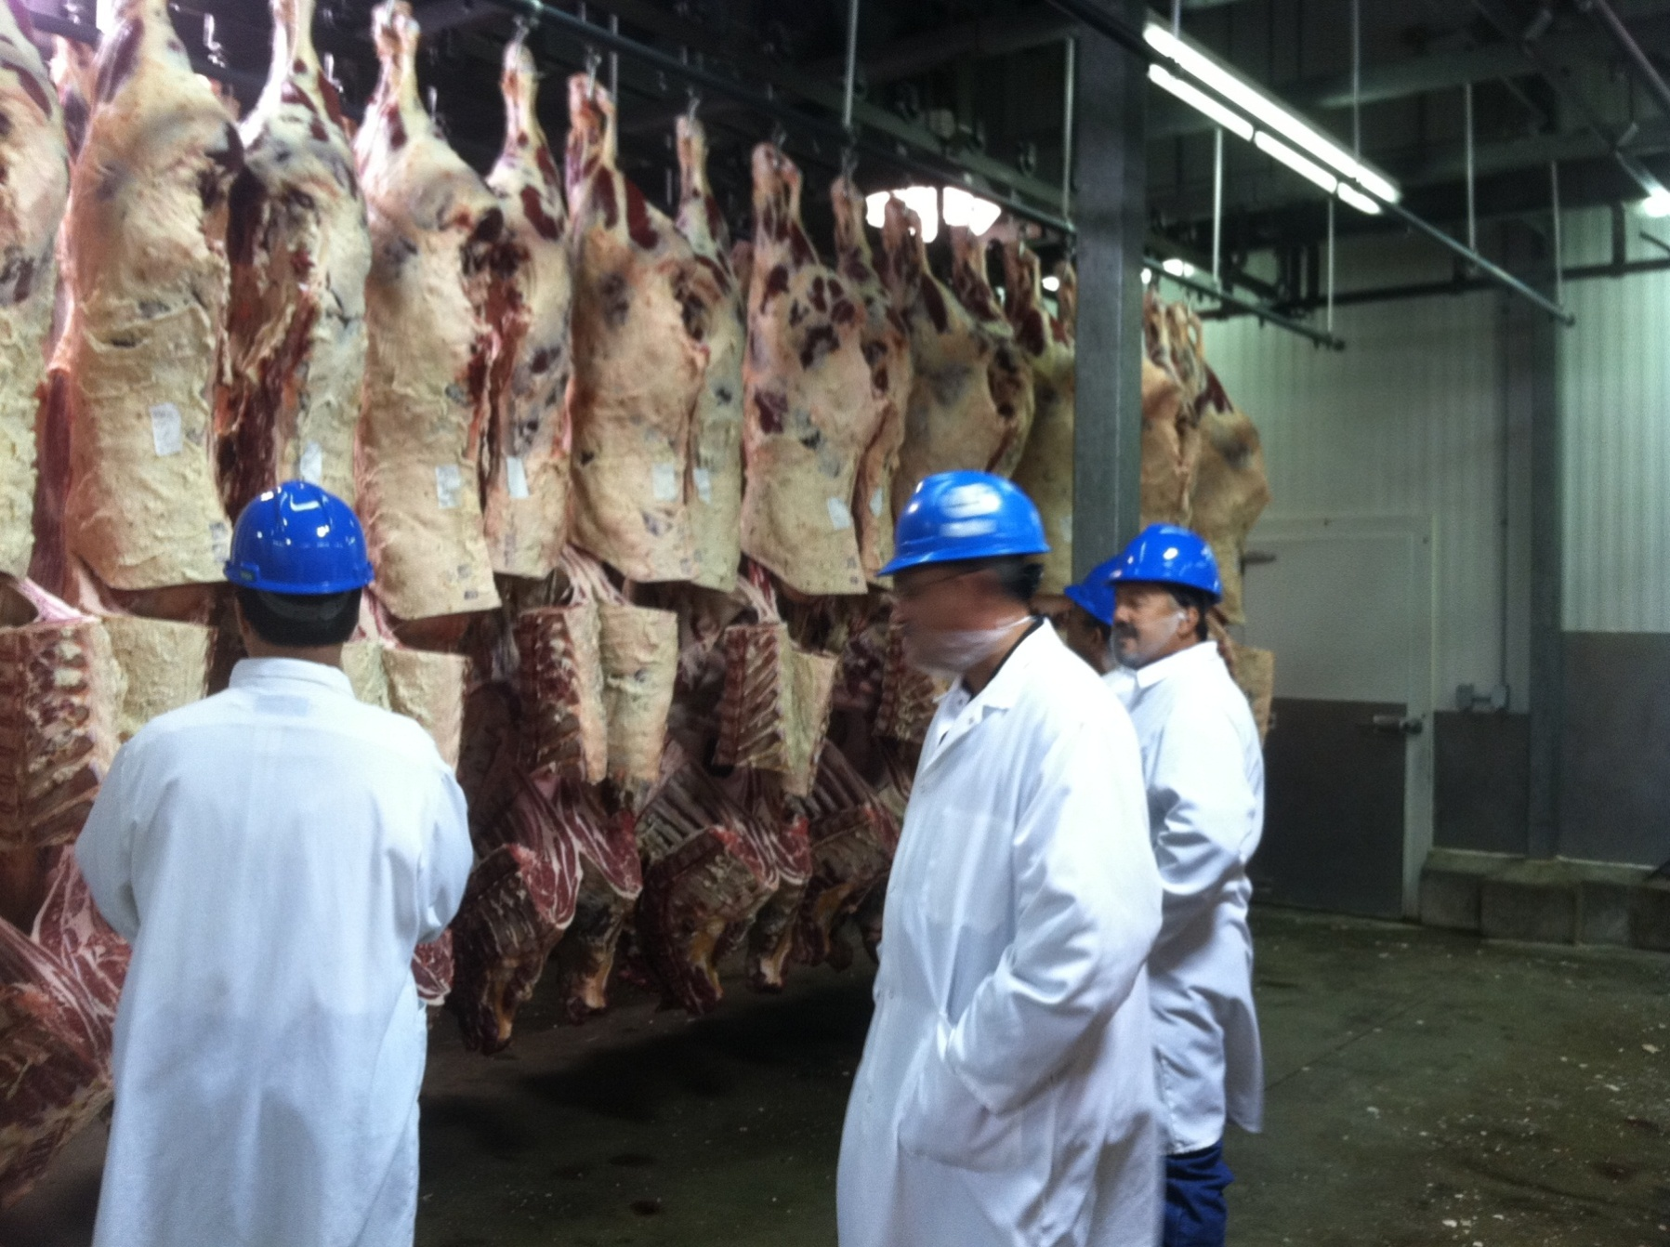

Slide 35
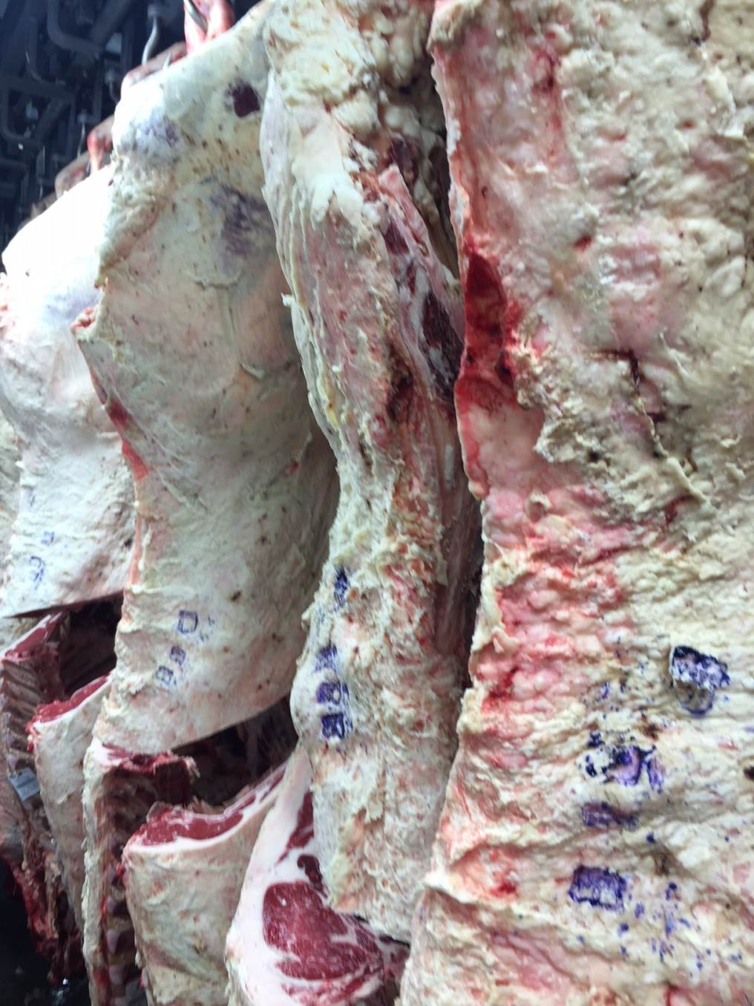
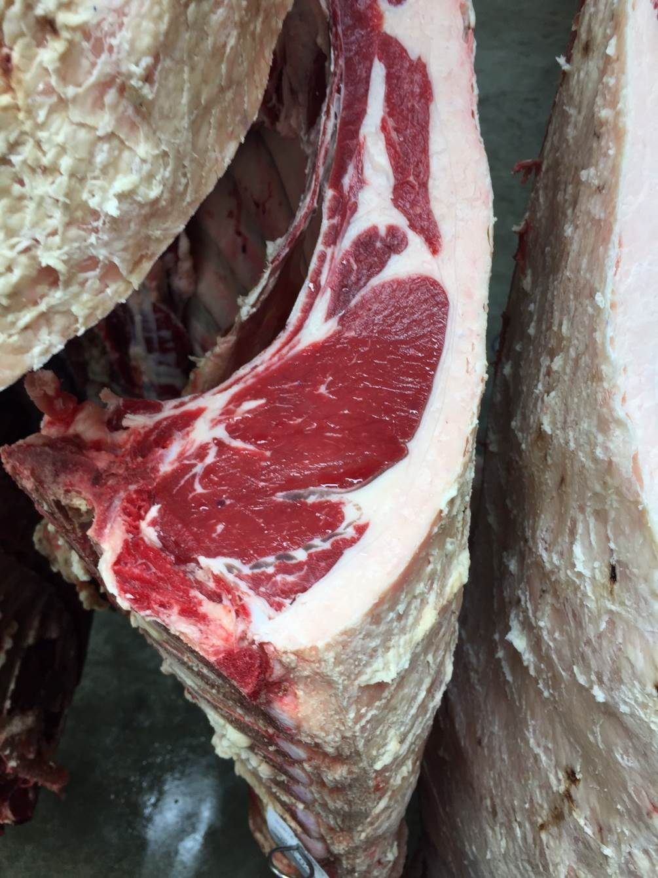

Slide 36
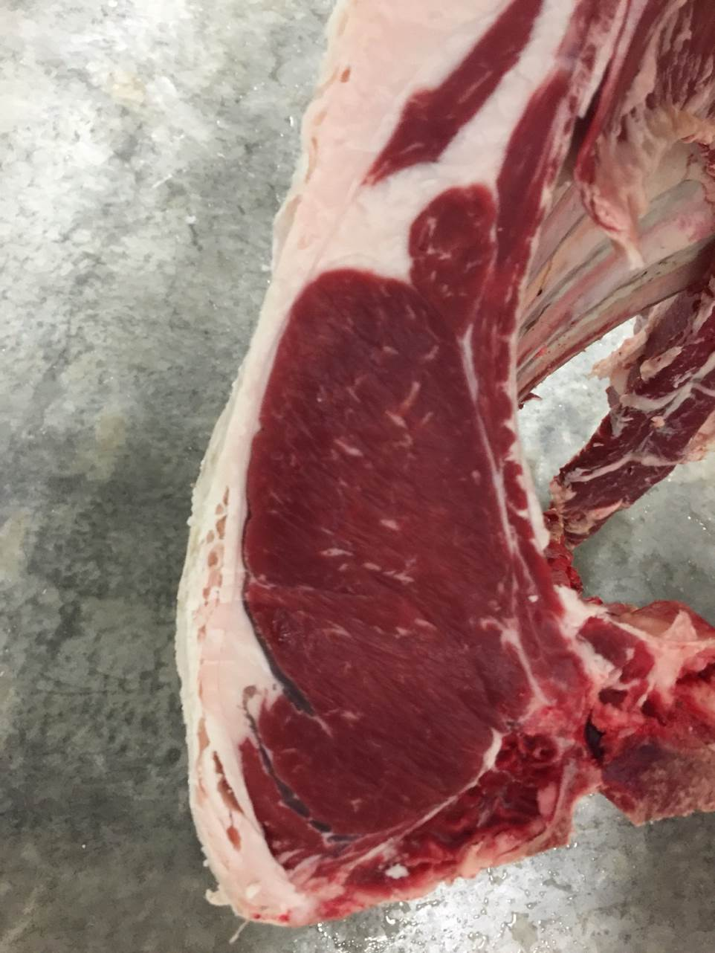
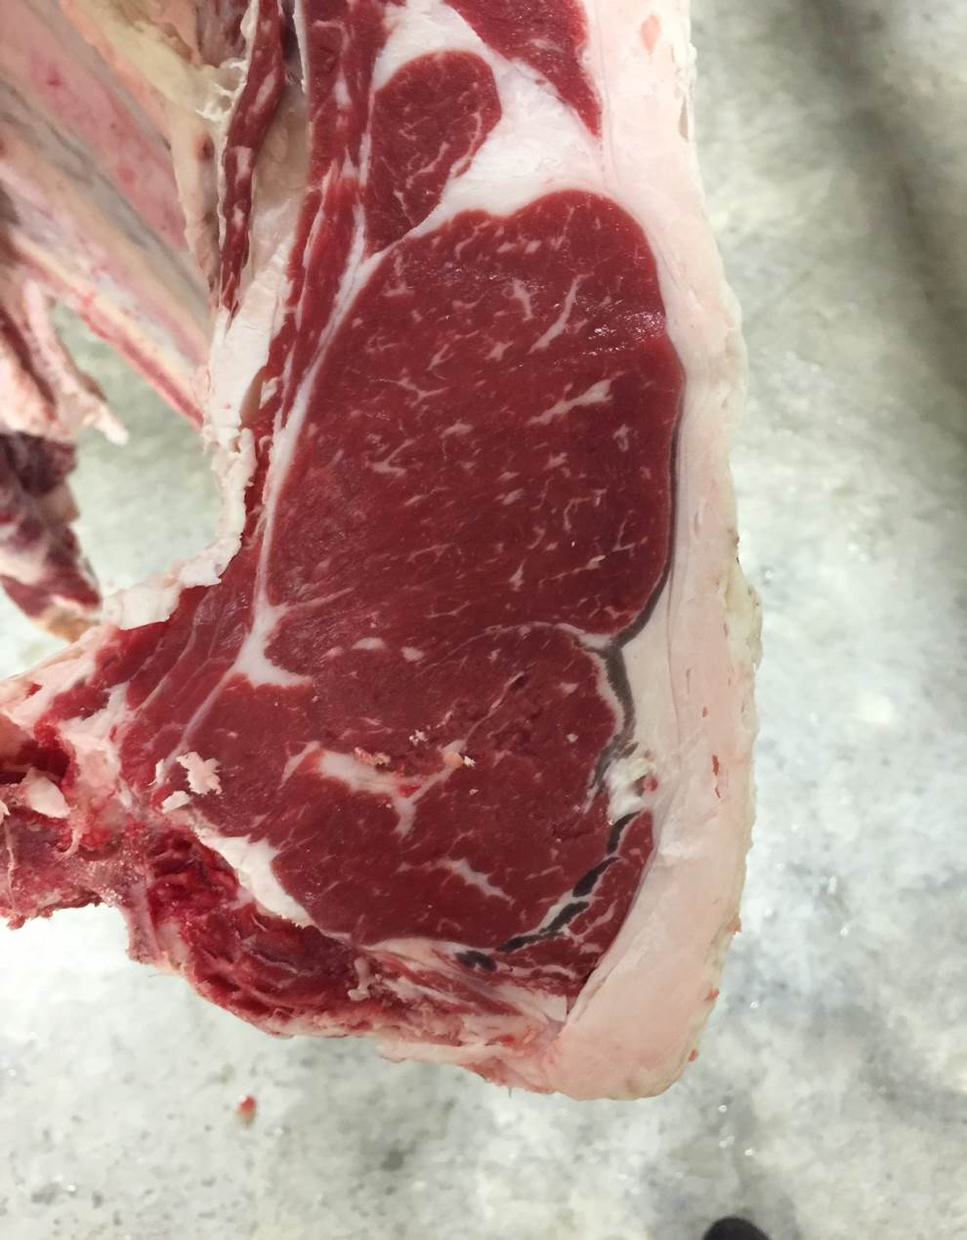

Slide 37
Building for Future Generations

Slide 38
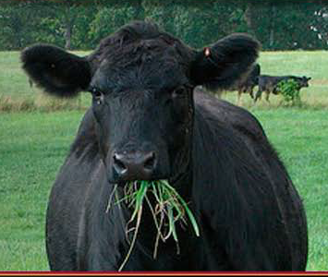
Thank you!

Slide 39
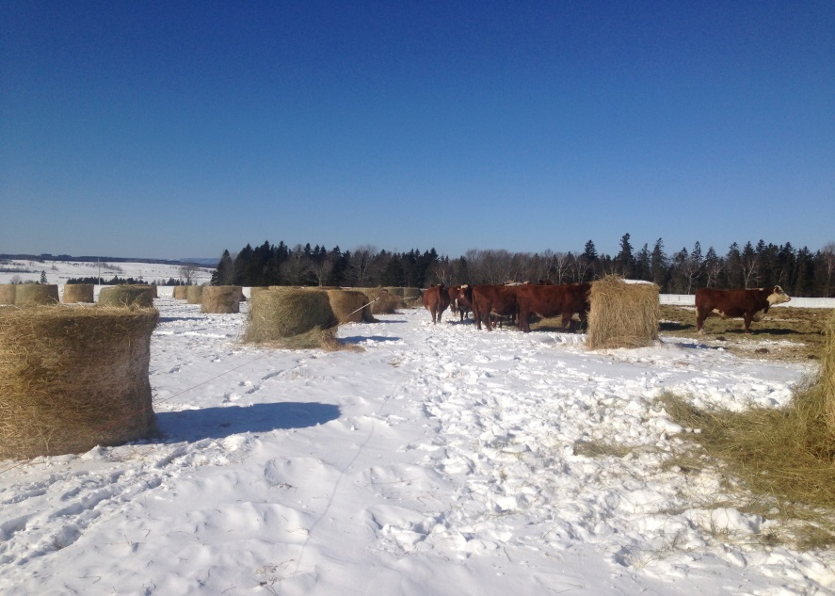
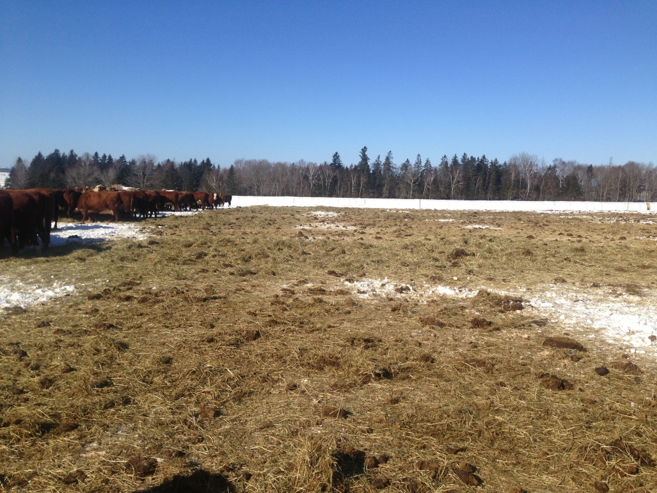
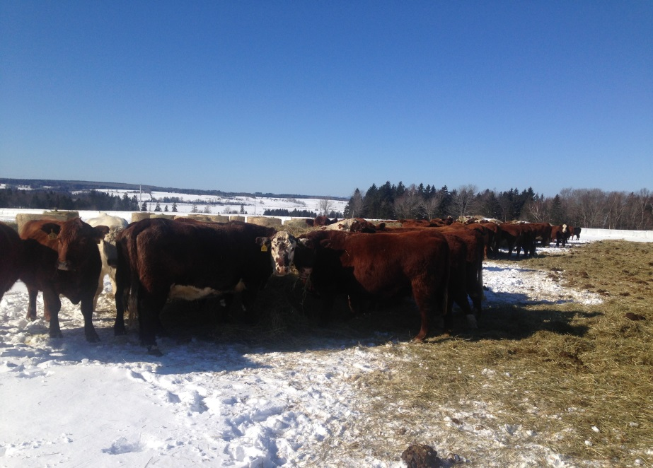
Winter Bale Grazing

Slide 40
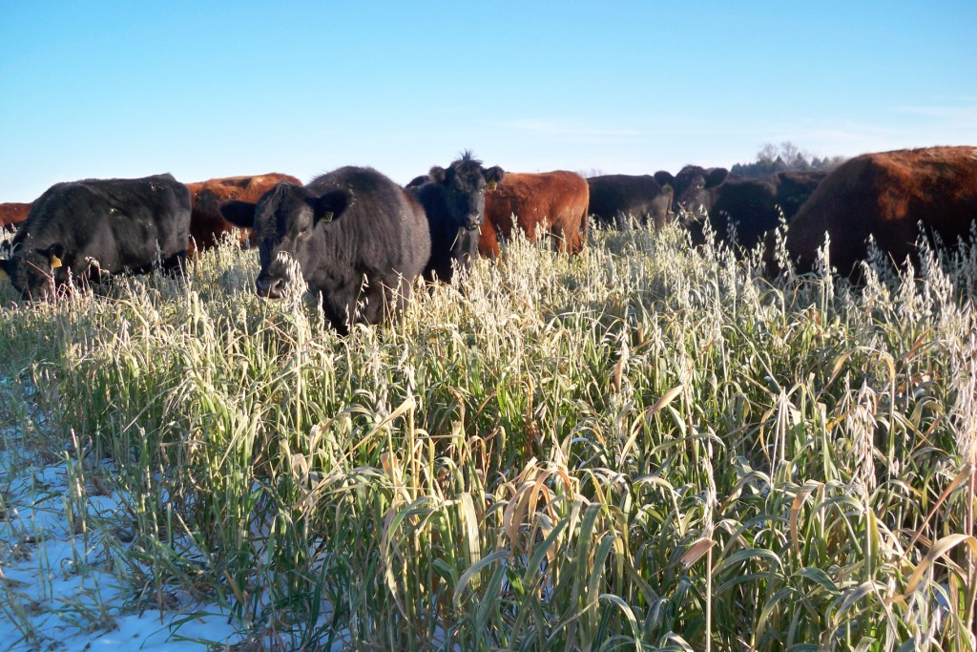
Winter Stockpile Grazing

Slide 41
Value of Winter Stockpile
Variable | Suggested Value | Sample Value
TDN | >60 | 65
NFD_{d} | 60-70 | 62
NE_{L} | 0.65 – 0.70 | 0.68
RFQ | 140-170 | 179

Slide 42
Millet: 9% CP 50% TDN Sorghum/Sudan: 12% CP 72% TDN

Slide 43
Hairy Vetch: 18% CP 70% TDN

Slide 44
Radish: 14% CP 70% TDN

Slide 45
Future of Agriculture
More Stacked Enterprises
Multispecies livestock
Beekeeping, beneficial insect raising
Integration of higher value crops
Specialty grains
Fruits and nuts
Vegetable and herbs
Recreational & entertainment
On Farm restaurants, cooking & canning schools, etc….

Slide 46
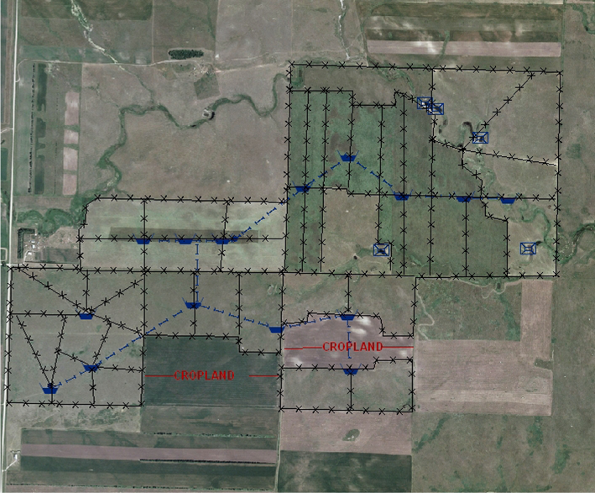
The “New” Farm
Bee Hives
Mixed fruit & nut orchards - interspersed
Multispecies Livestock
Hunting, fishing, recreational, agri-tourism, clinics
Specialty Grains, organic crops, specialty crops

