Slide 1
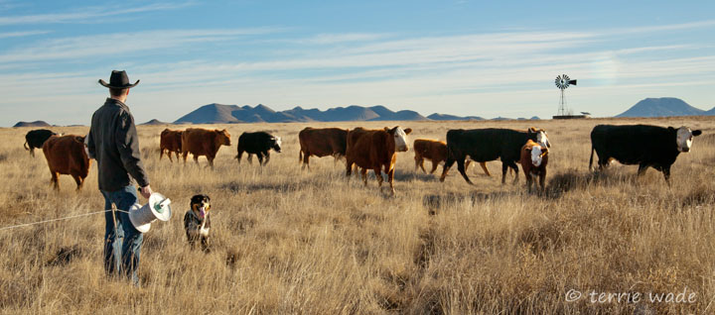
Holistic Management®
DIXON RANCHES SUCCESS STORIES
Holistic Management International
5941 Jefferson St. NE, Ste B
Albuquerque, NM 87109
http://www.holisticmanagement.org
Dixon Water Foundation
Decatur and Marfa, TX
432-729-4600 ✪ 940-768-2740
http://www.dixonwater.org
Notes:
Text

Slide 2
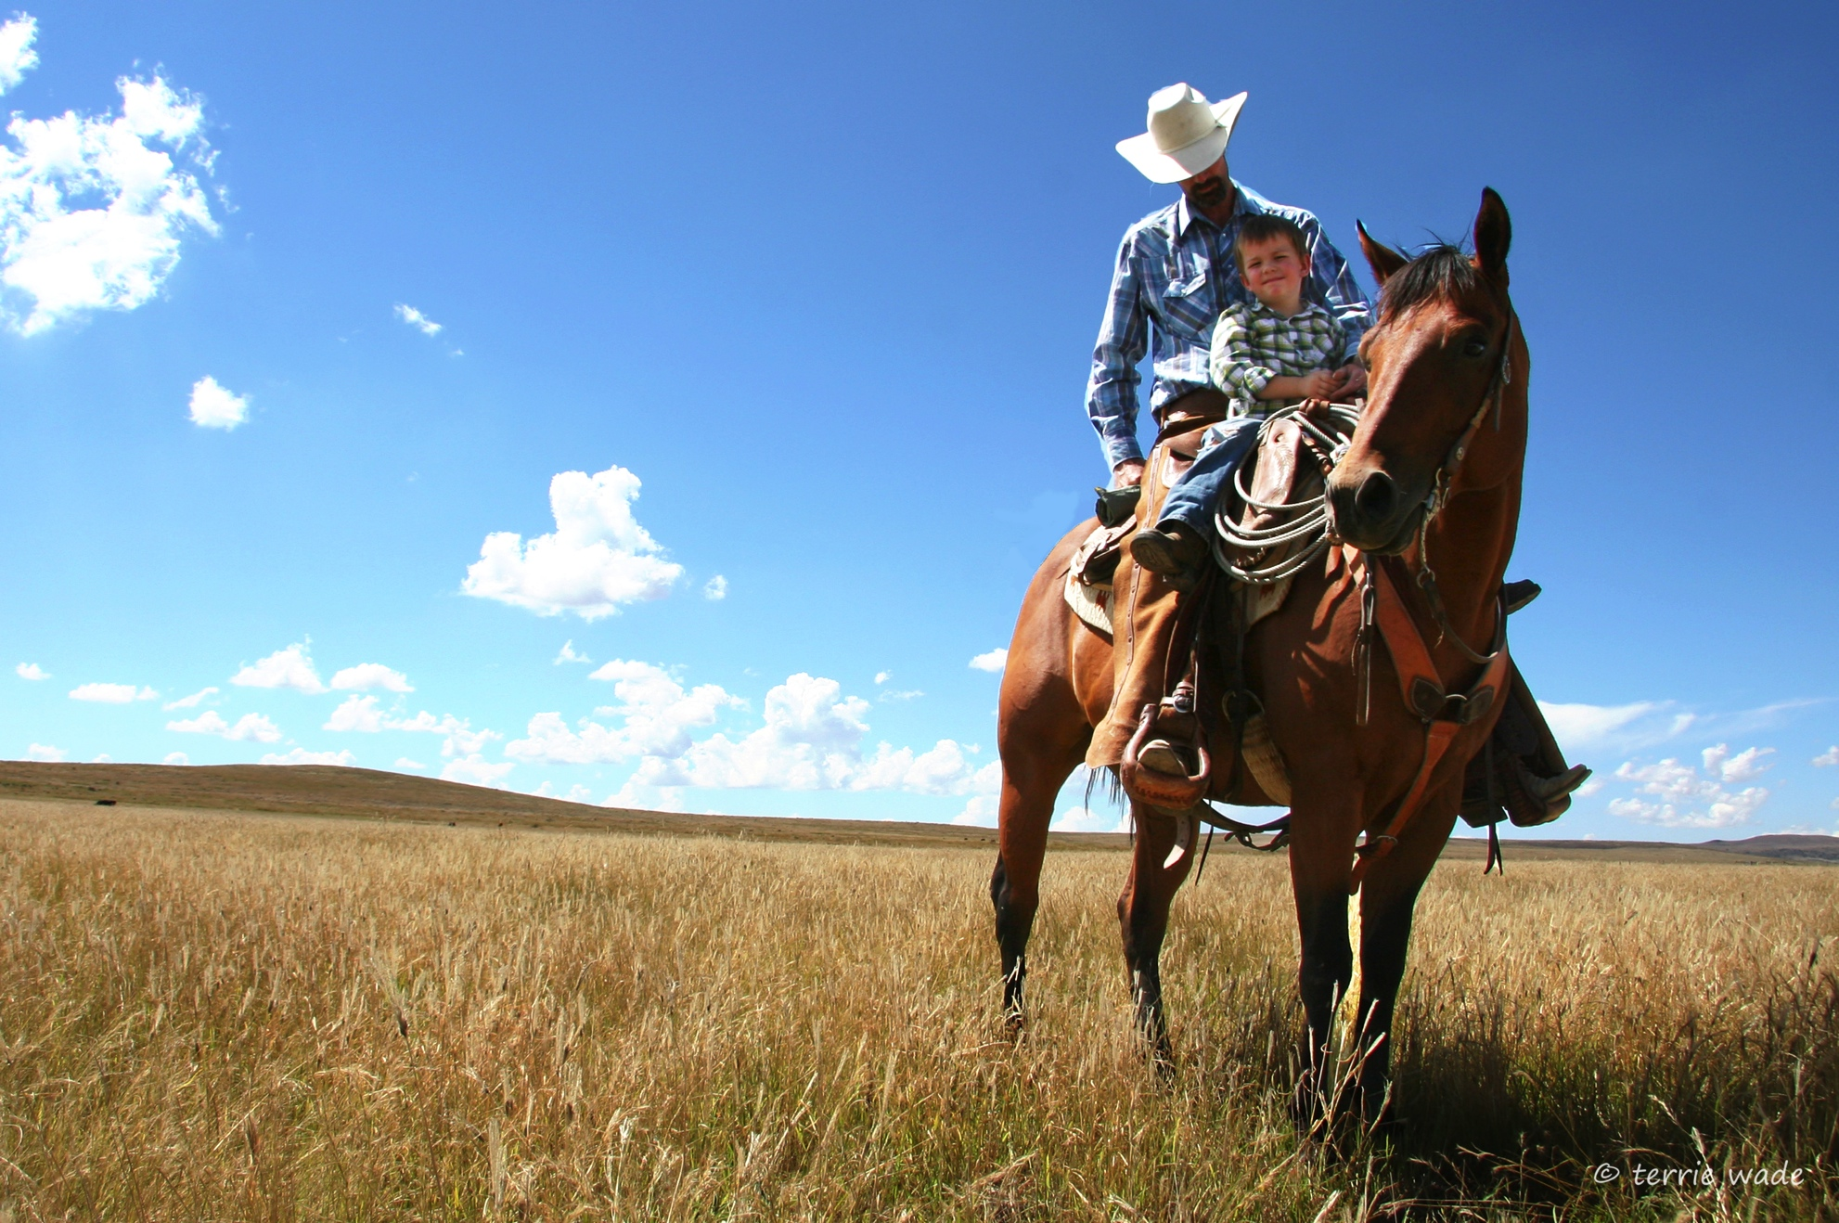
CASEY WADE
Vice President Ranching Operations

Slide 3
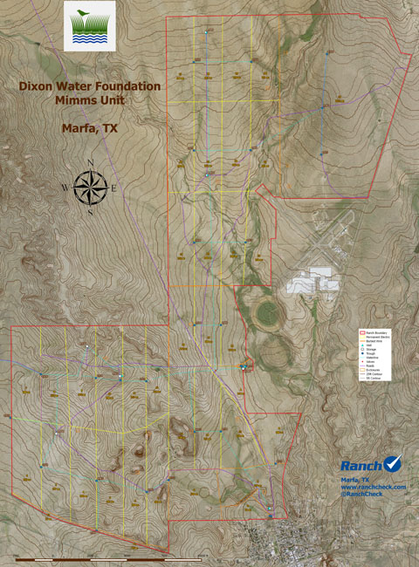
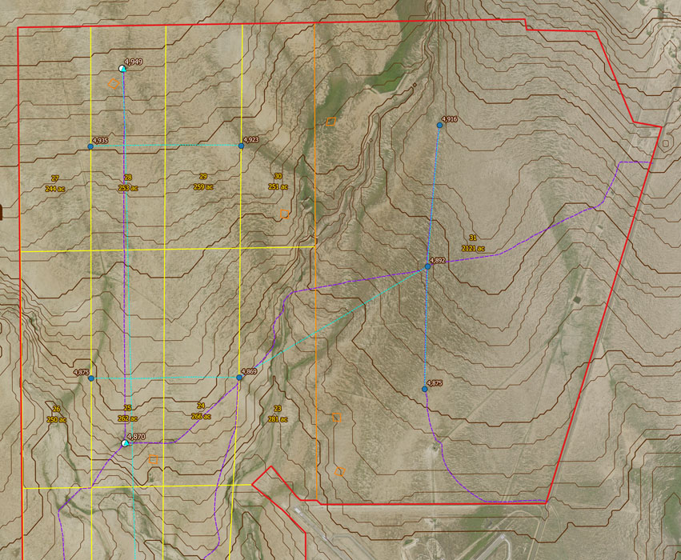
DIXON RANCHES MIMMS UNIT DETAIL

Slide 4
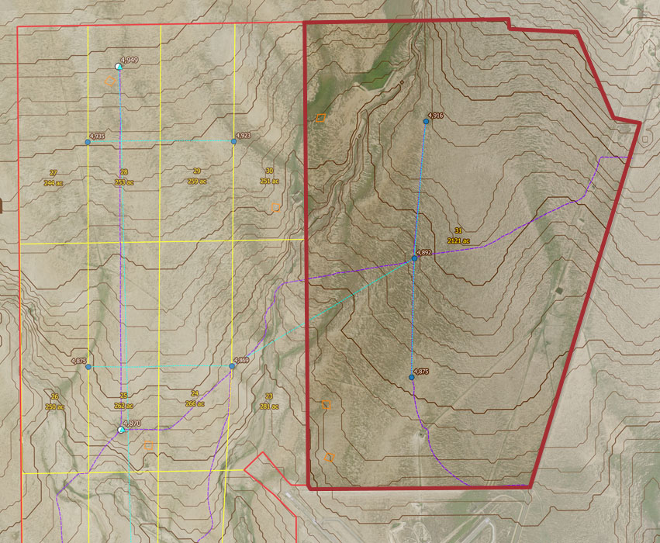
CONTINUOUS GRAZING
DIXON RANCHES MIMMS UNIT DETAIL

Slide 5
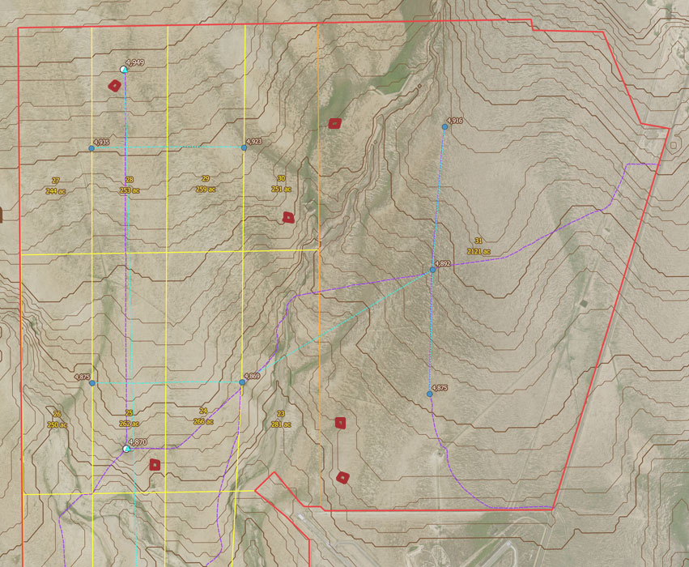
EXCLOSURES
DIXON RANCHES MIMMS UNIT DETAIL

Slide 6
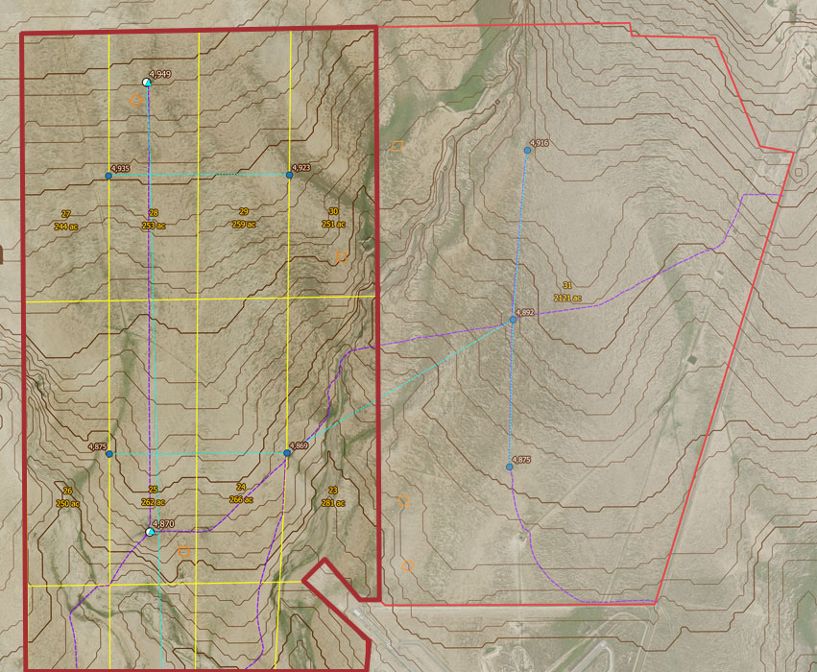
ROTATIONAL GRAZING
DIXON RANCHES MIMMS UNIT DETAIL

Slide 7
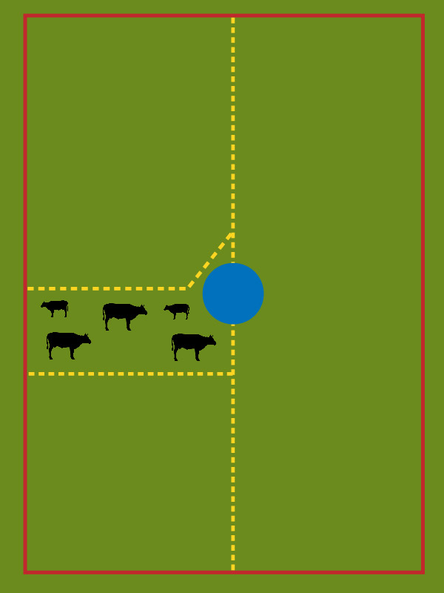
ROTATIONAL PADDOCKS:
DAY 1
PERMANENT FENCE
WATER
TEMPORARY
ELECTRIC FENCE

Slide 8
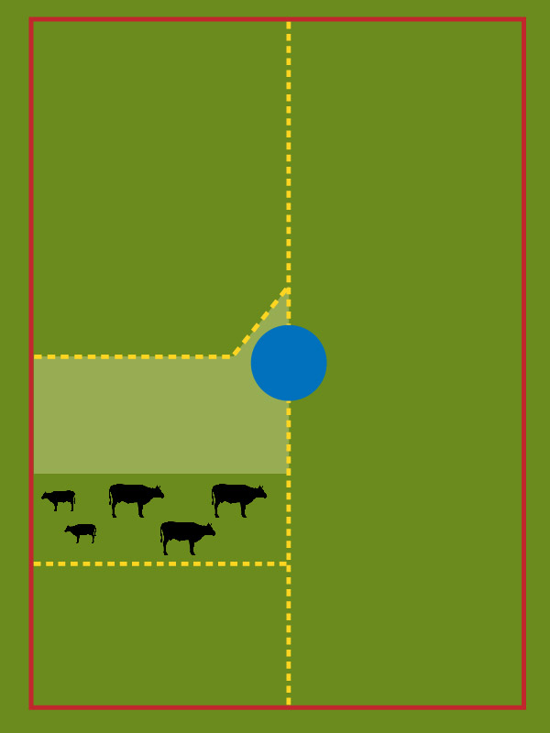
ROTATIONAL PADDOCKS:
DAY 2

Slide 9
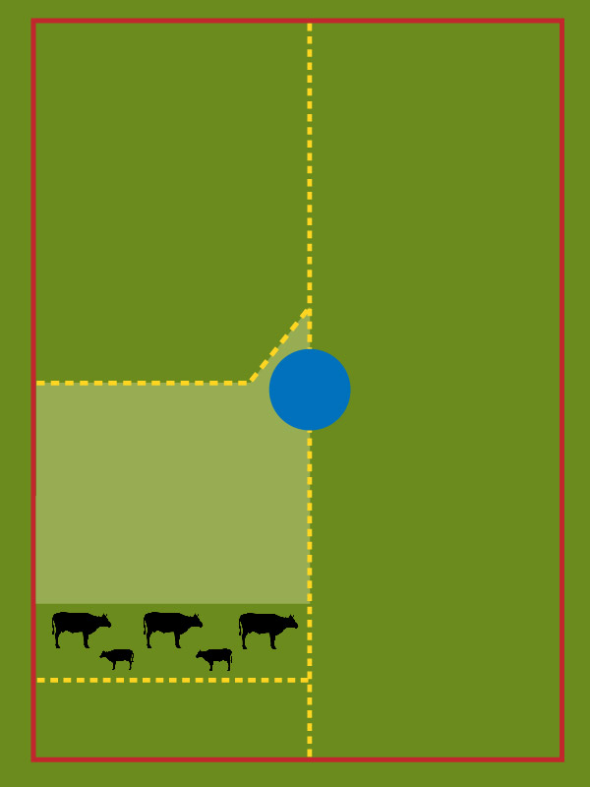
ROTATIONAL PADDOCKS:
DAY 3

Slide 10
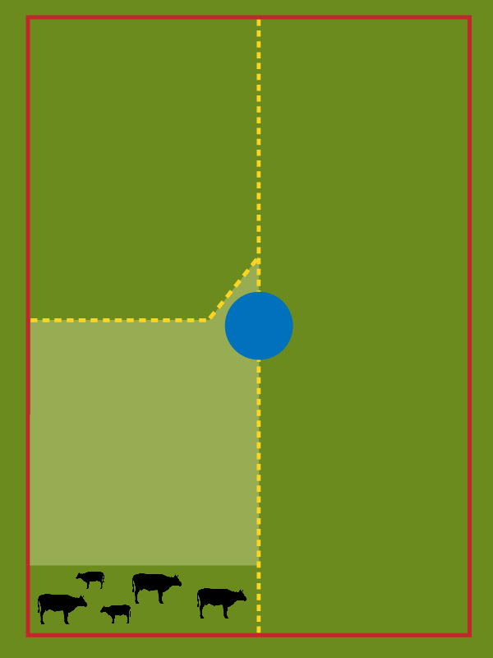
ROTATIONAL PADDOCKS:
DAY 4

Slide 11
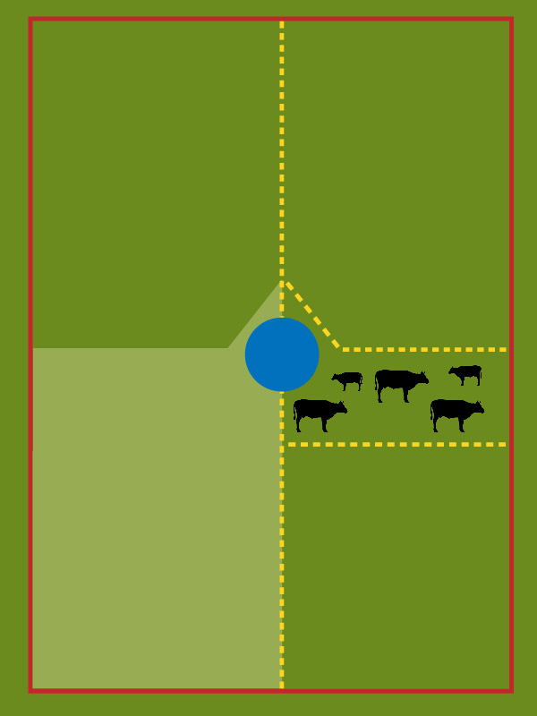
ROTATIONAL PADDOCKS:
DAY 5

Slide 12
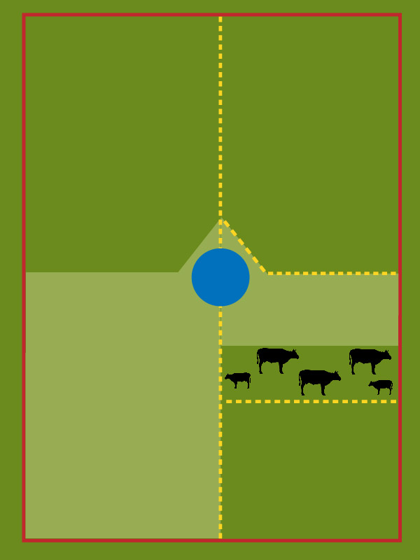
ROTATIONAL PADDOCKS:
DAY 6

Slide 13
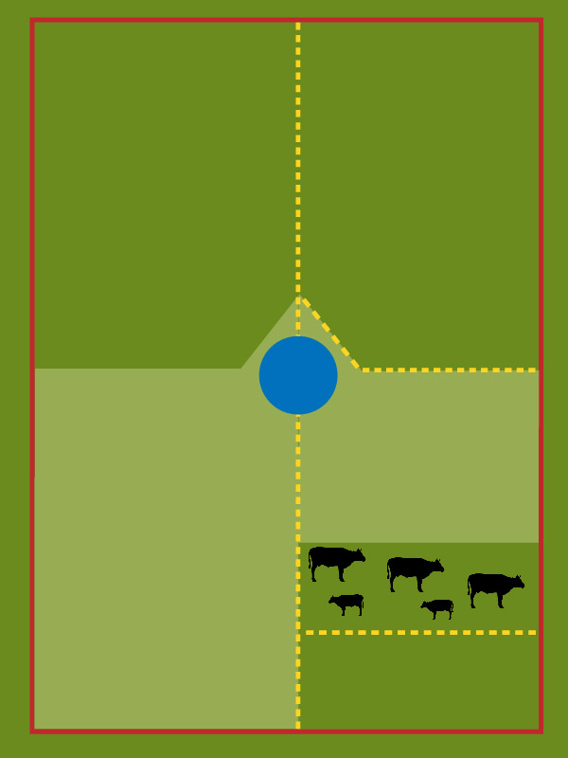
ROTATIONAL PADDOCKS:
DAY 7

Slide 14
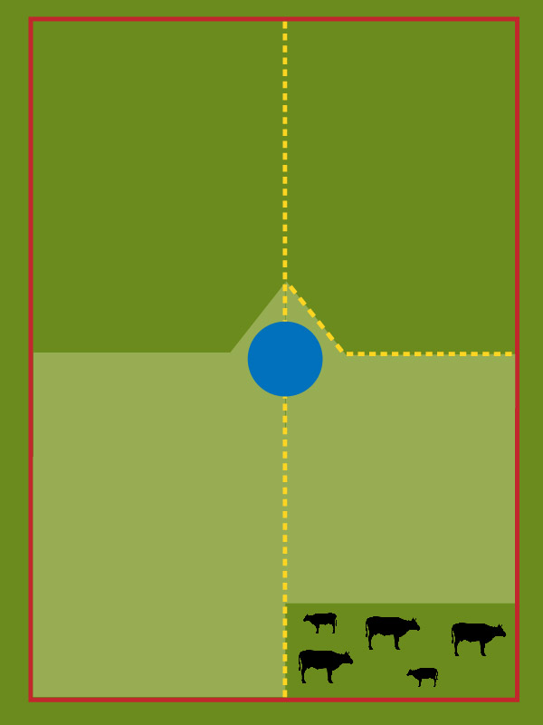
ROTATIONAL PADDOCKS:
DAY 8

Slide 15
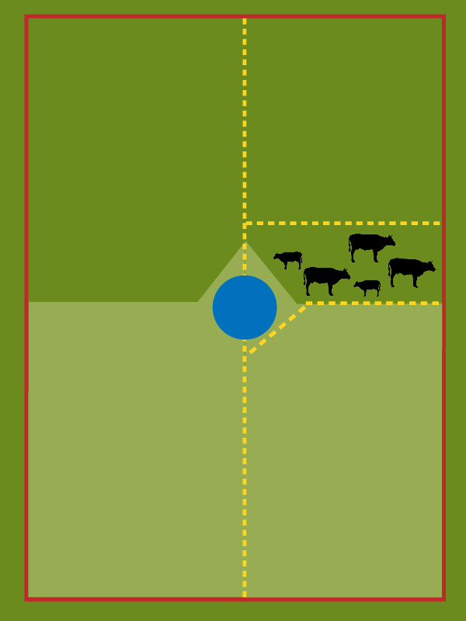
ROTATIONAL PADDOCKS:
DAY 9

Slide 16
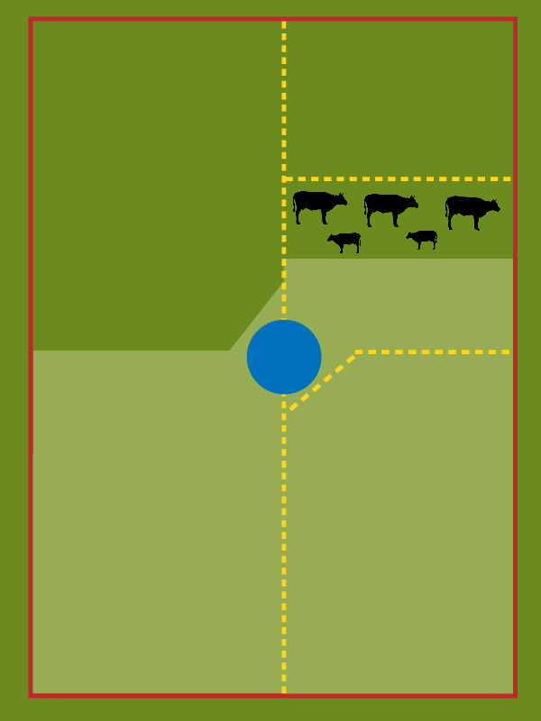
ROTATIONAL PADDOCKS:
DAY 10

Slide 17
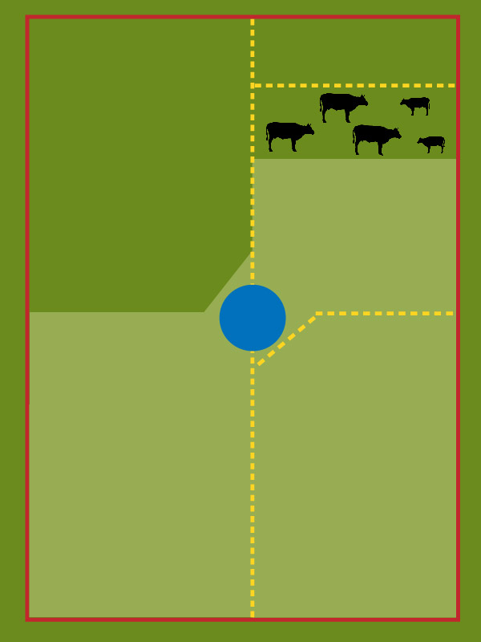
ROTATIONAL PADDOCKS:
DAY 11

Slide 18
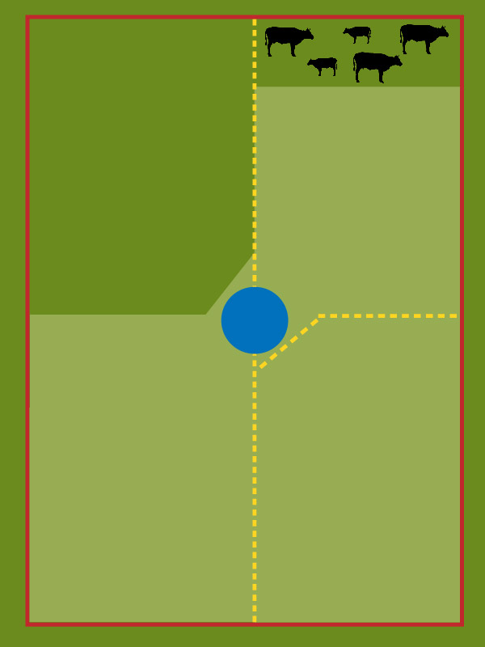
ROTATIONAL PADDOCKS:
DAY 12

Slide 19
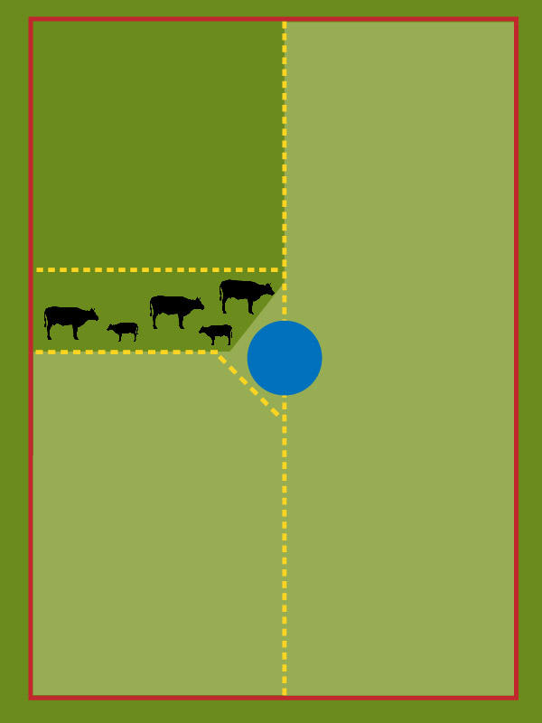
ROTATIONAL PADDOCKS:
DAY 13

Slide 20
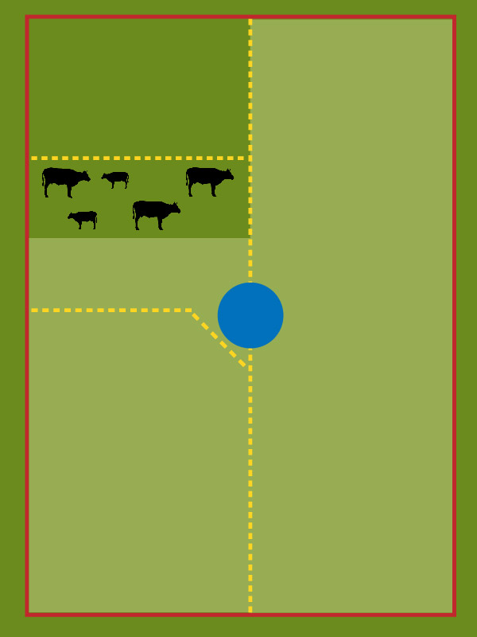
ROTATIONAL PADDOCKS:
DAY 14

Slide 21
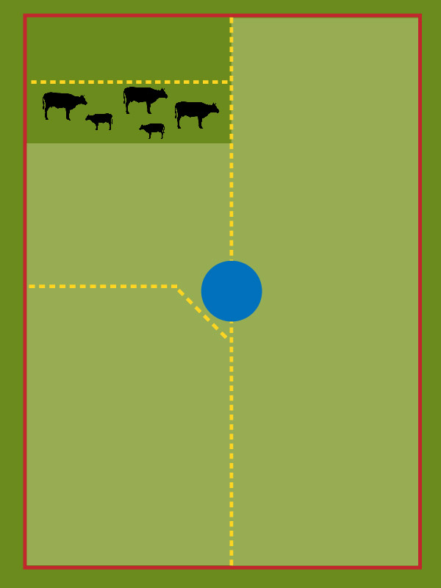
ROTATIONAL PADDOCKS:
DAY 15

Slide 22
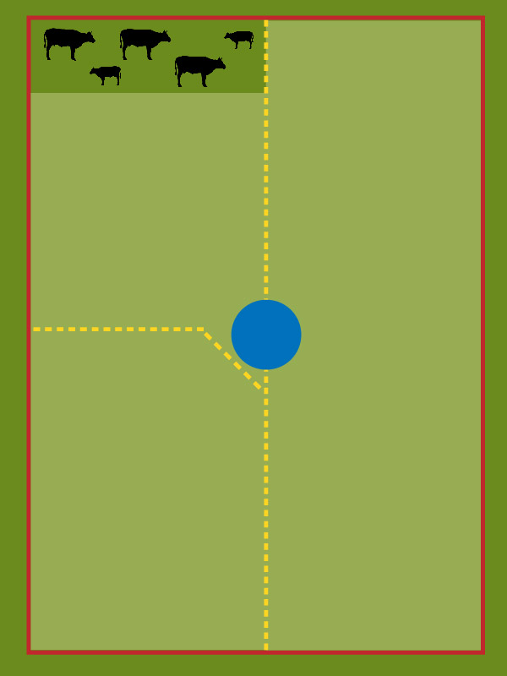
ROTATIONAL PADDOCKS:
DAY 16

Slide 23
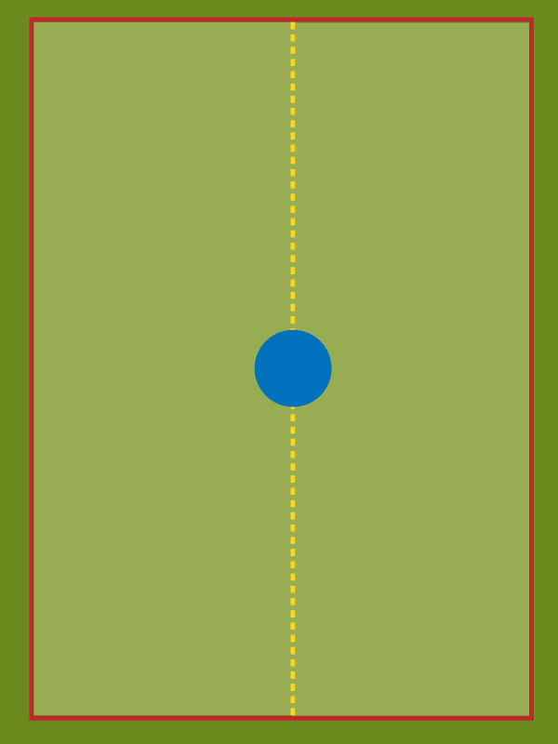
ROTATIONAL PADDOCKS:
DAY 17

Slide 24
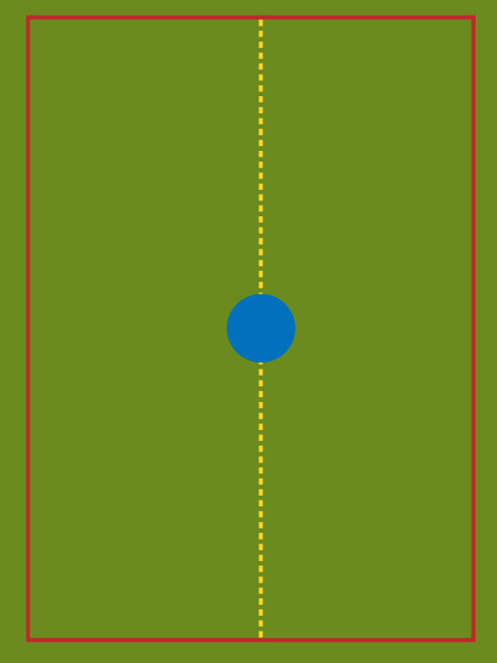
ROTATIONAL PADDOCKS:
ONE YEAR LATER

Slide 25

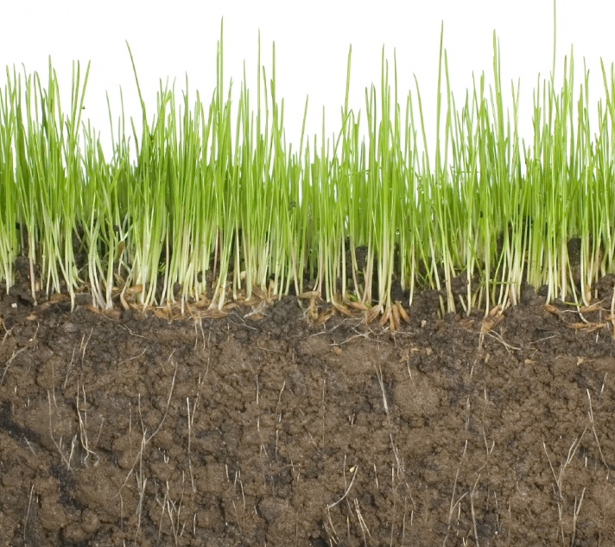
GRAZING AND GRASS RE-GROWTH

Slide 26

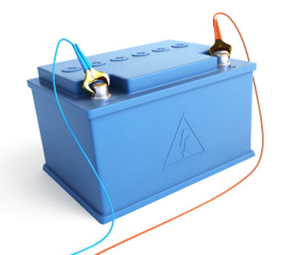
GRAZING AND GRASS RE-GROWTH

Slide 27
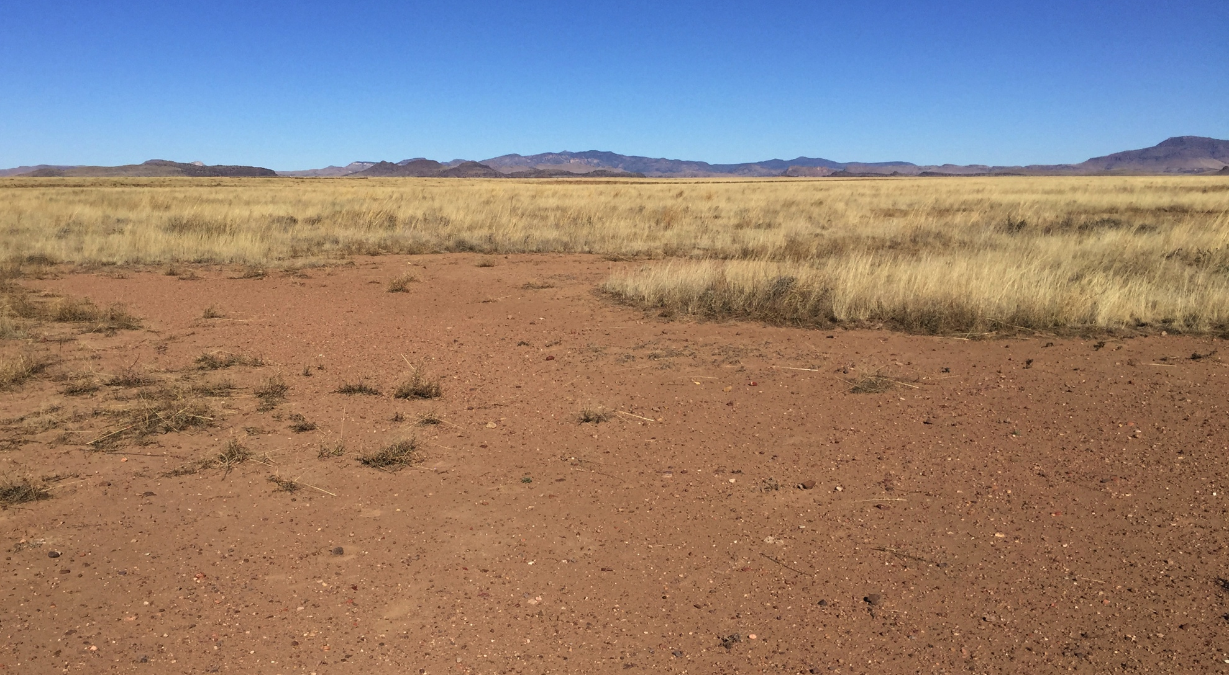
THE PROBLEM: BARE GROUND

Slide 28
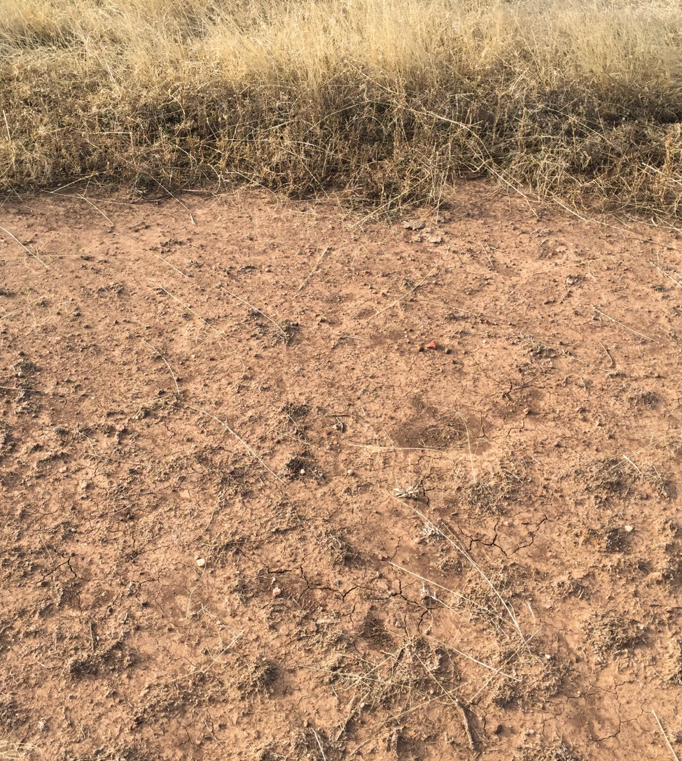
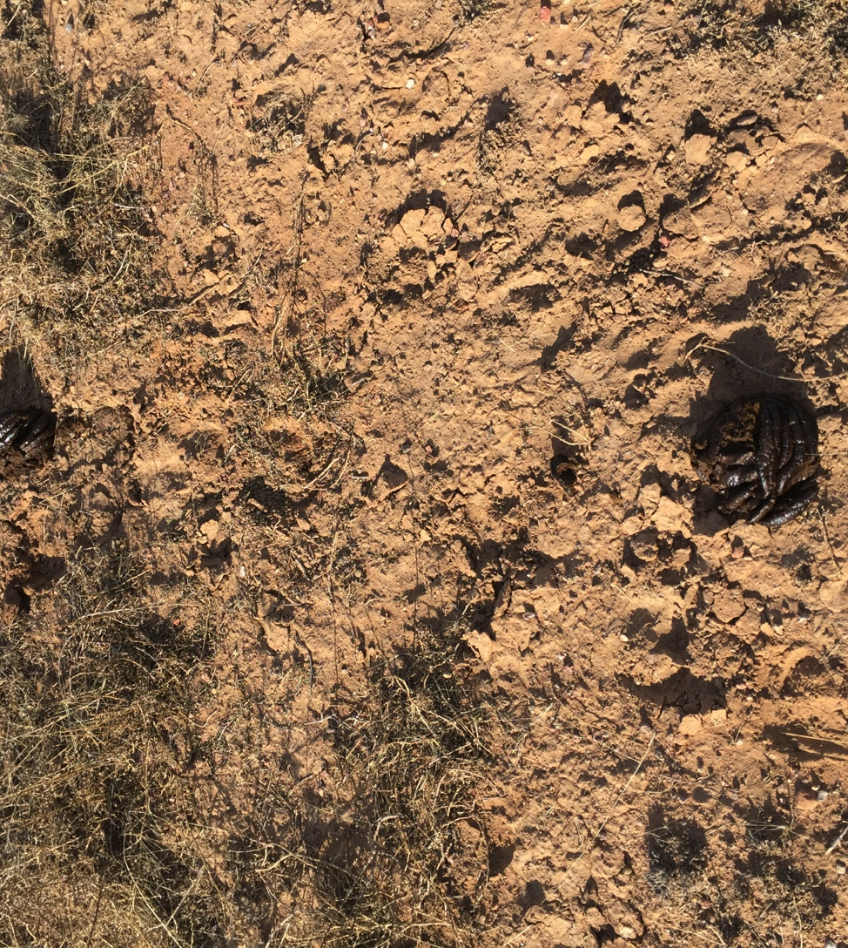
BARE GROUND COMPARISON
CONTINUOUS GRAZING
ROTATIONAL GRAZING

Slide 29
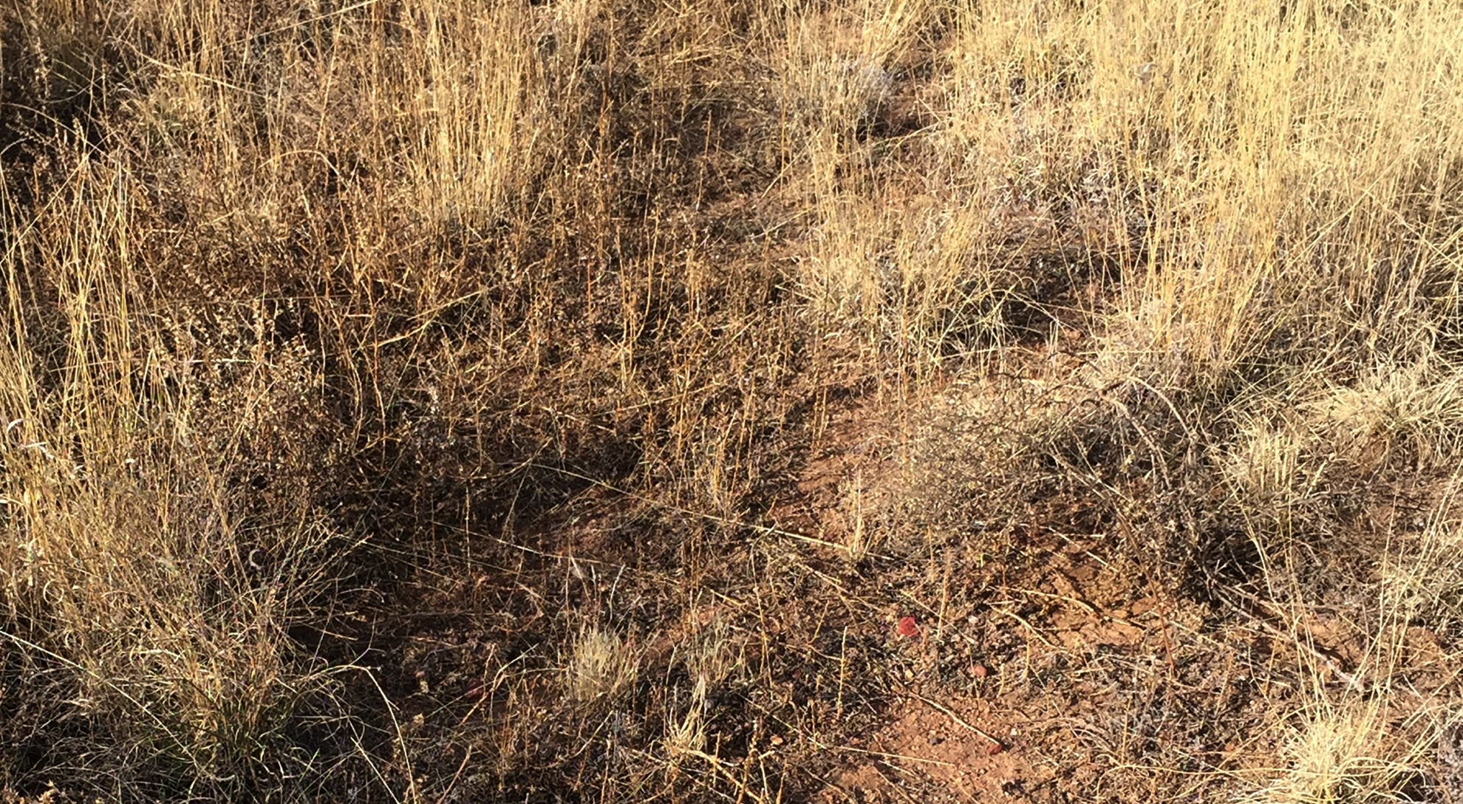
RECOVERING BARE GROUND

Slide 30
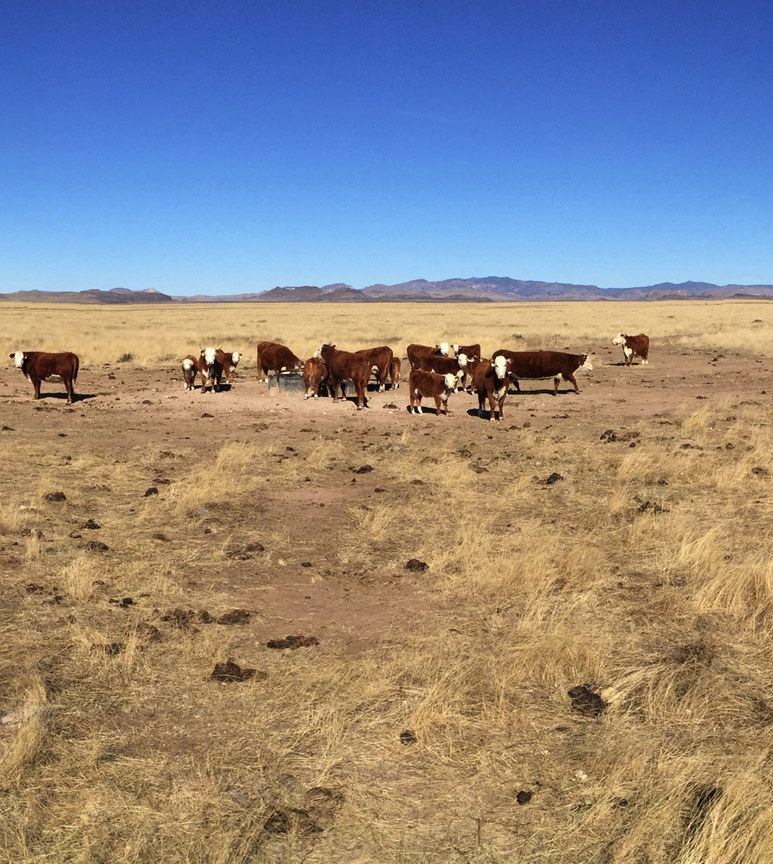
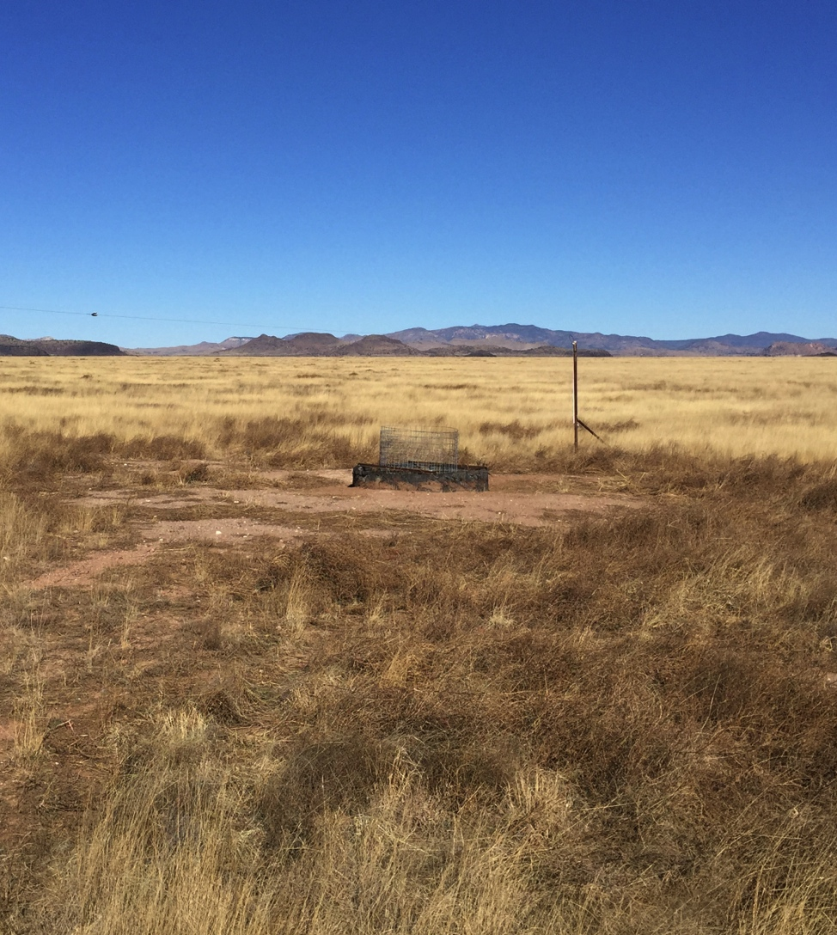
WATER POINTS
CONTINUOUS GRAZING
ROTATIONAL GRAZING

Slide 31
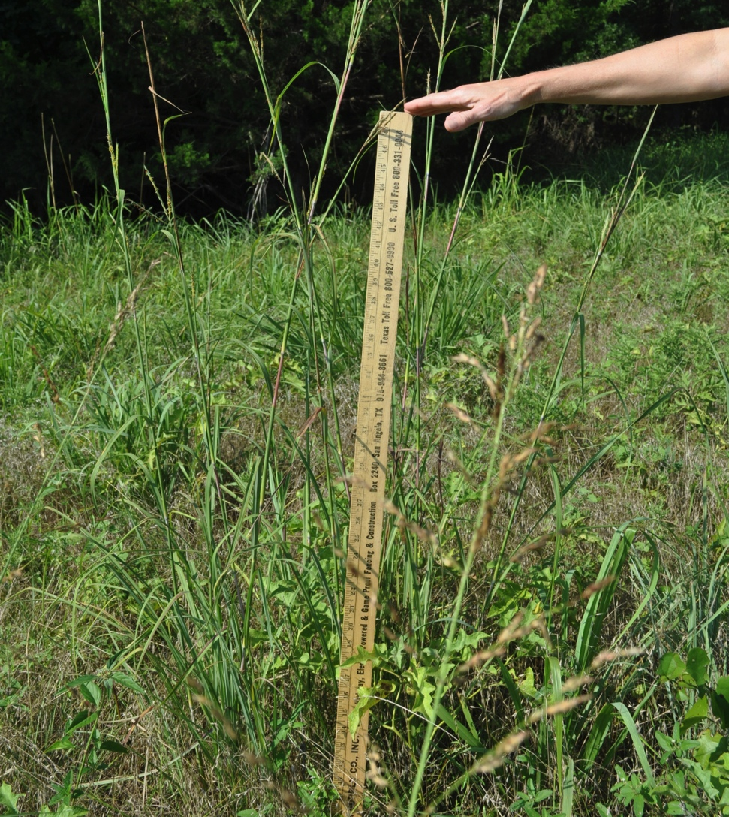
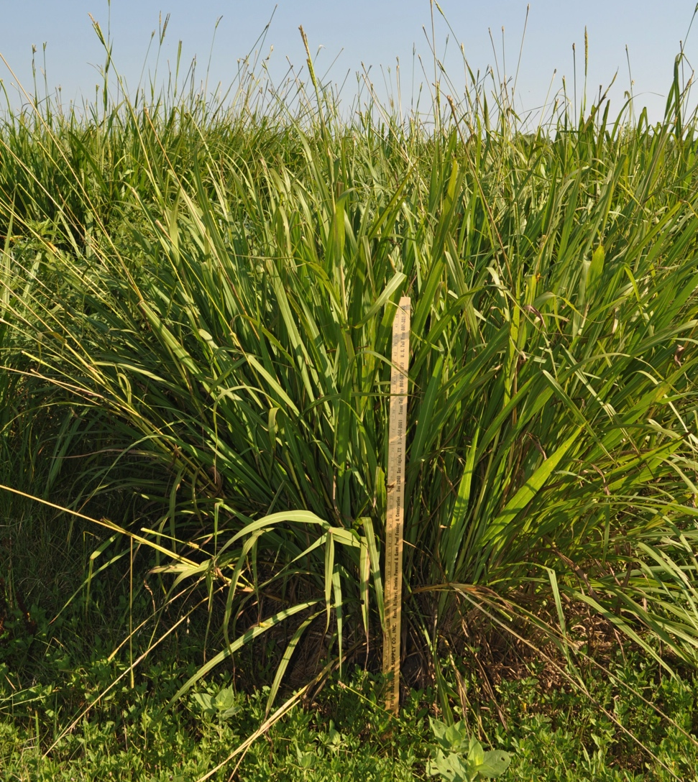
NORTH TEXAS RECOVERY
TERRACED FARM FIELD
➔ BIG BLUESTEM
BERMUDA GRASS HAYFIELD ➔ EASTERN GAMAGRASS

Slide 32
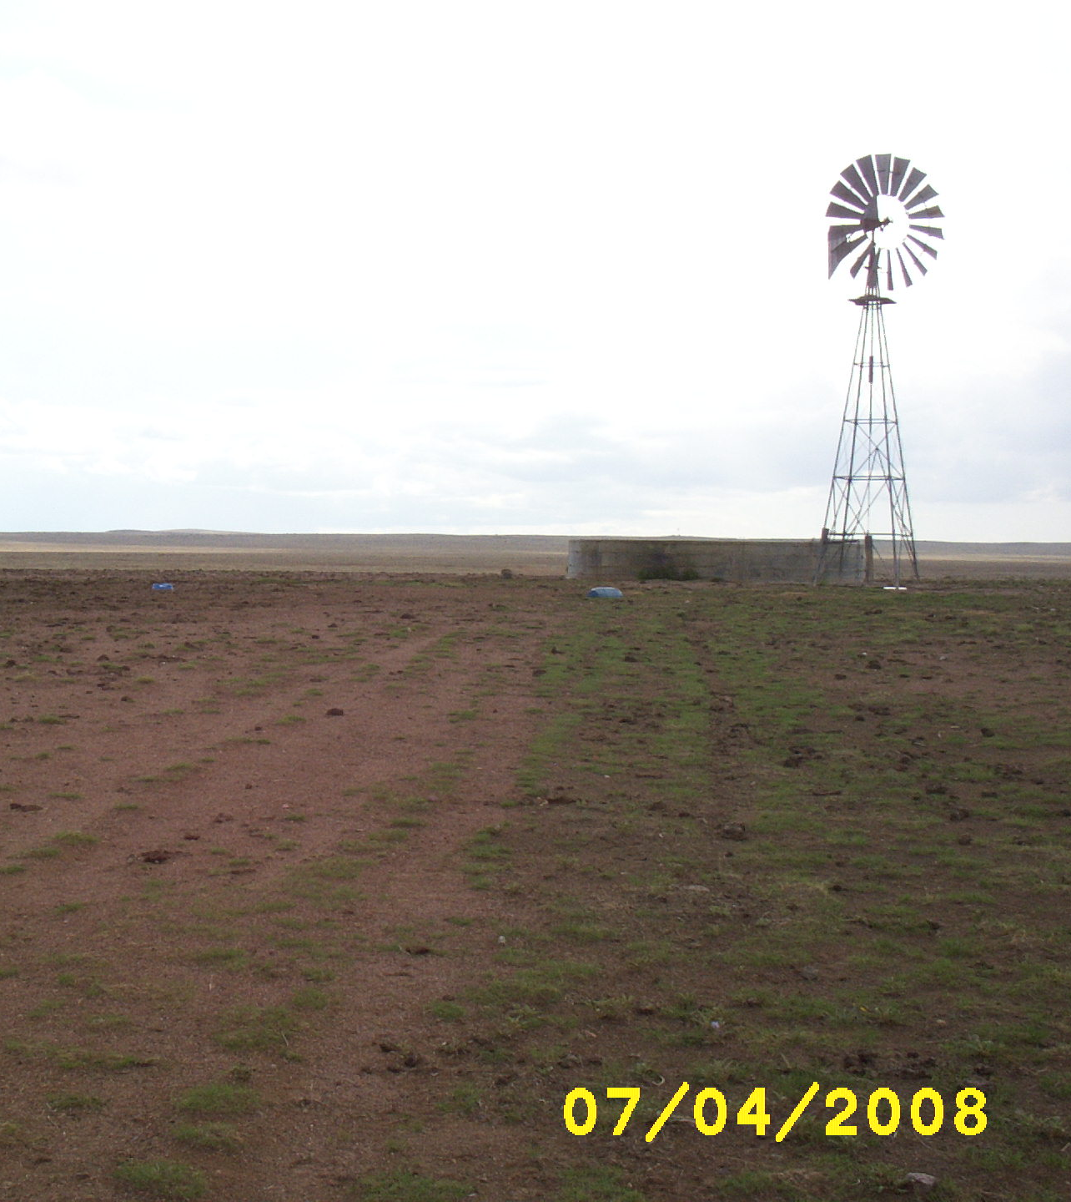
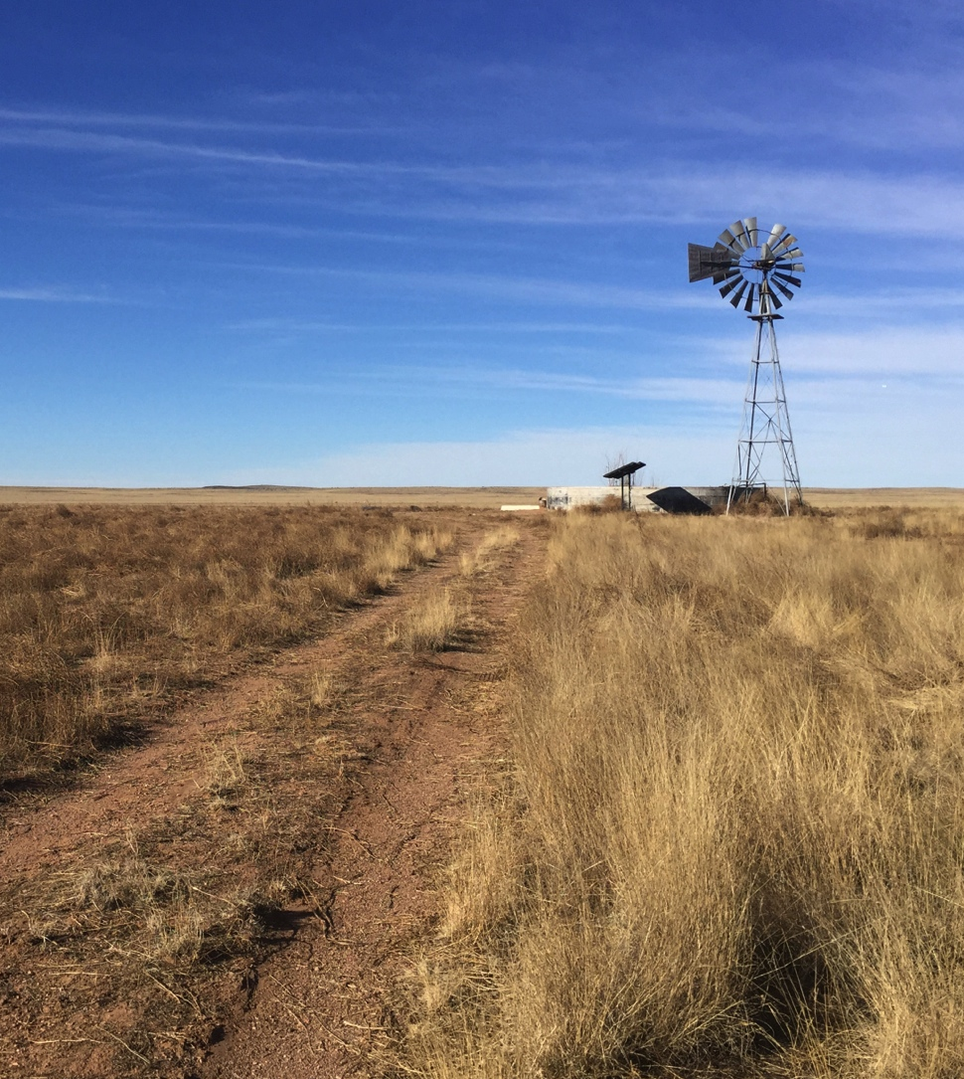
WEST TEXAS RECOVERY
JANUARY 2017

Slide 33
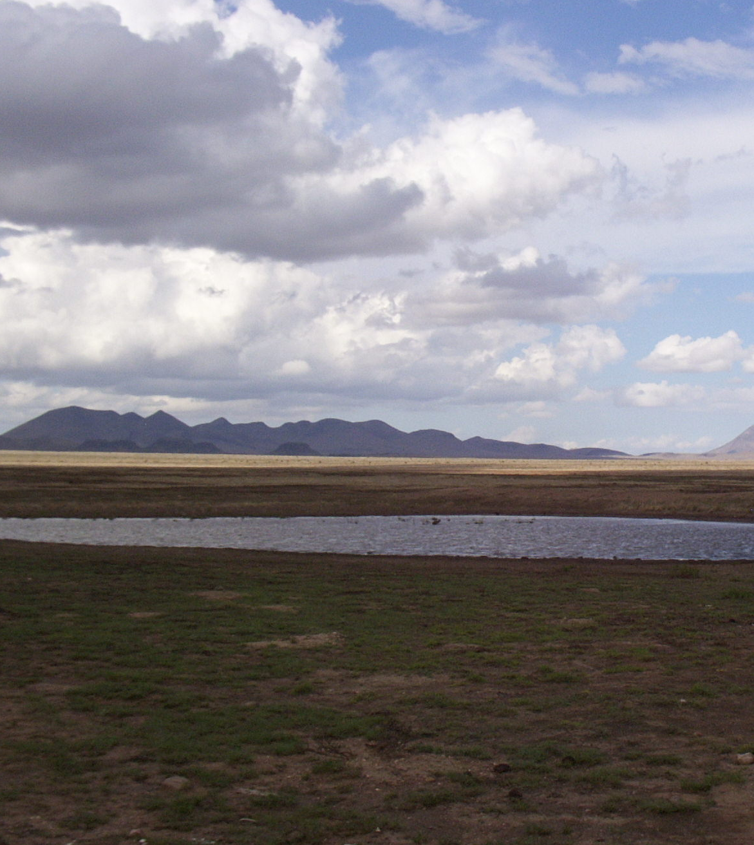
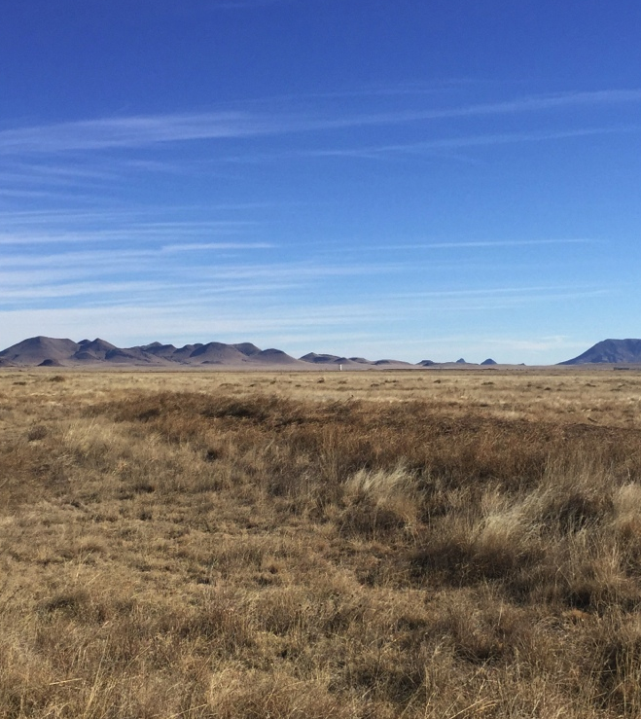
WEST TEXAS RECOVERY
2008
2017

Slide 34
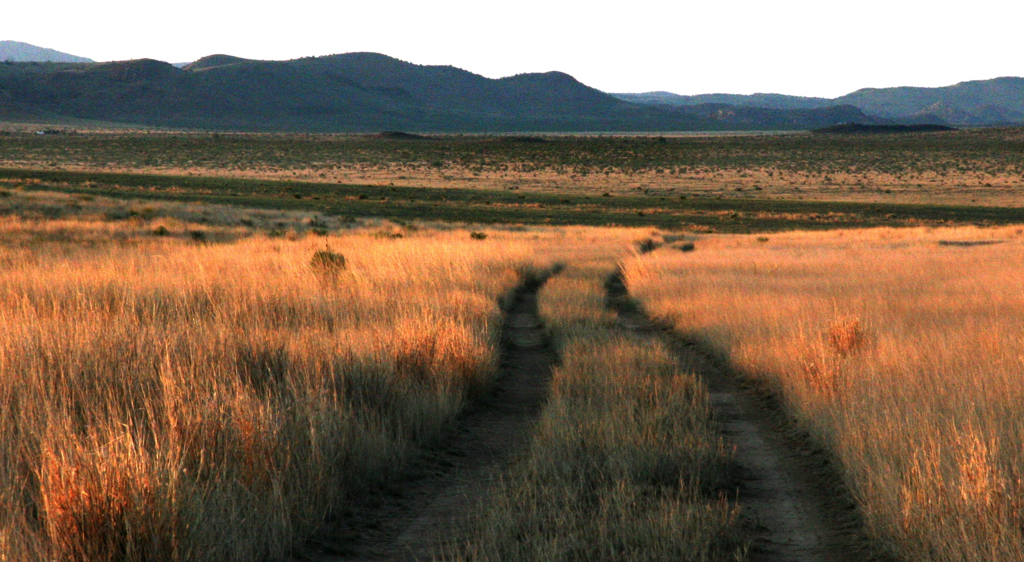
DIXON WATER FOUNDATION
940-768‐2740 ✪ 432-729-4600 ✪ dixonwater.org

