Slide 1
Small Mammal and Grassland Bird Response to Wildfire on the Marfa Grasslands, Texas
Bobby Allcorn, Department of Natural Resource Management
Dr. Bonnie J. Warnock, Dept. Chair, Department of Natural Resource Management
Dr. Christopher Ritzi, Dept. Chair, Biology, Geology, and Physical Sciences
Dr. Ryan Luna, Assistant Professor, Department of Natural Resource Management

Slide 2
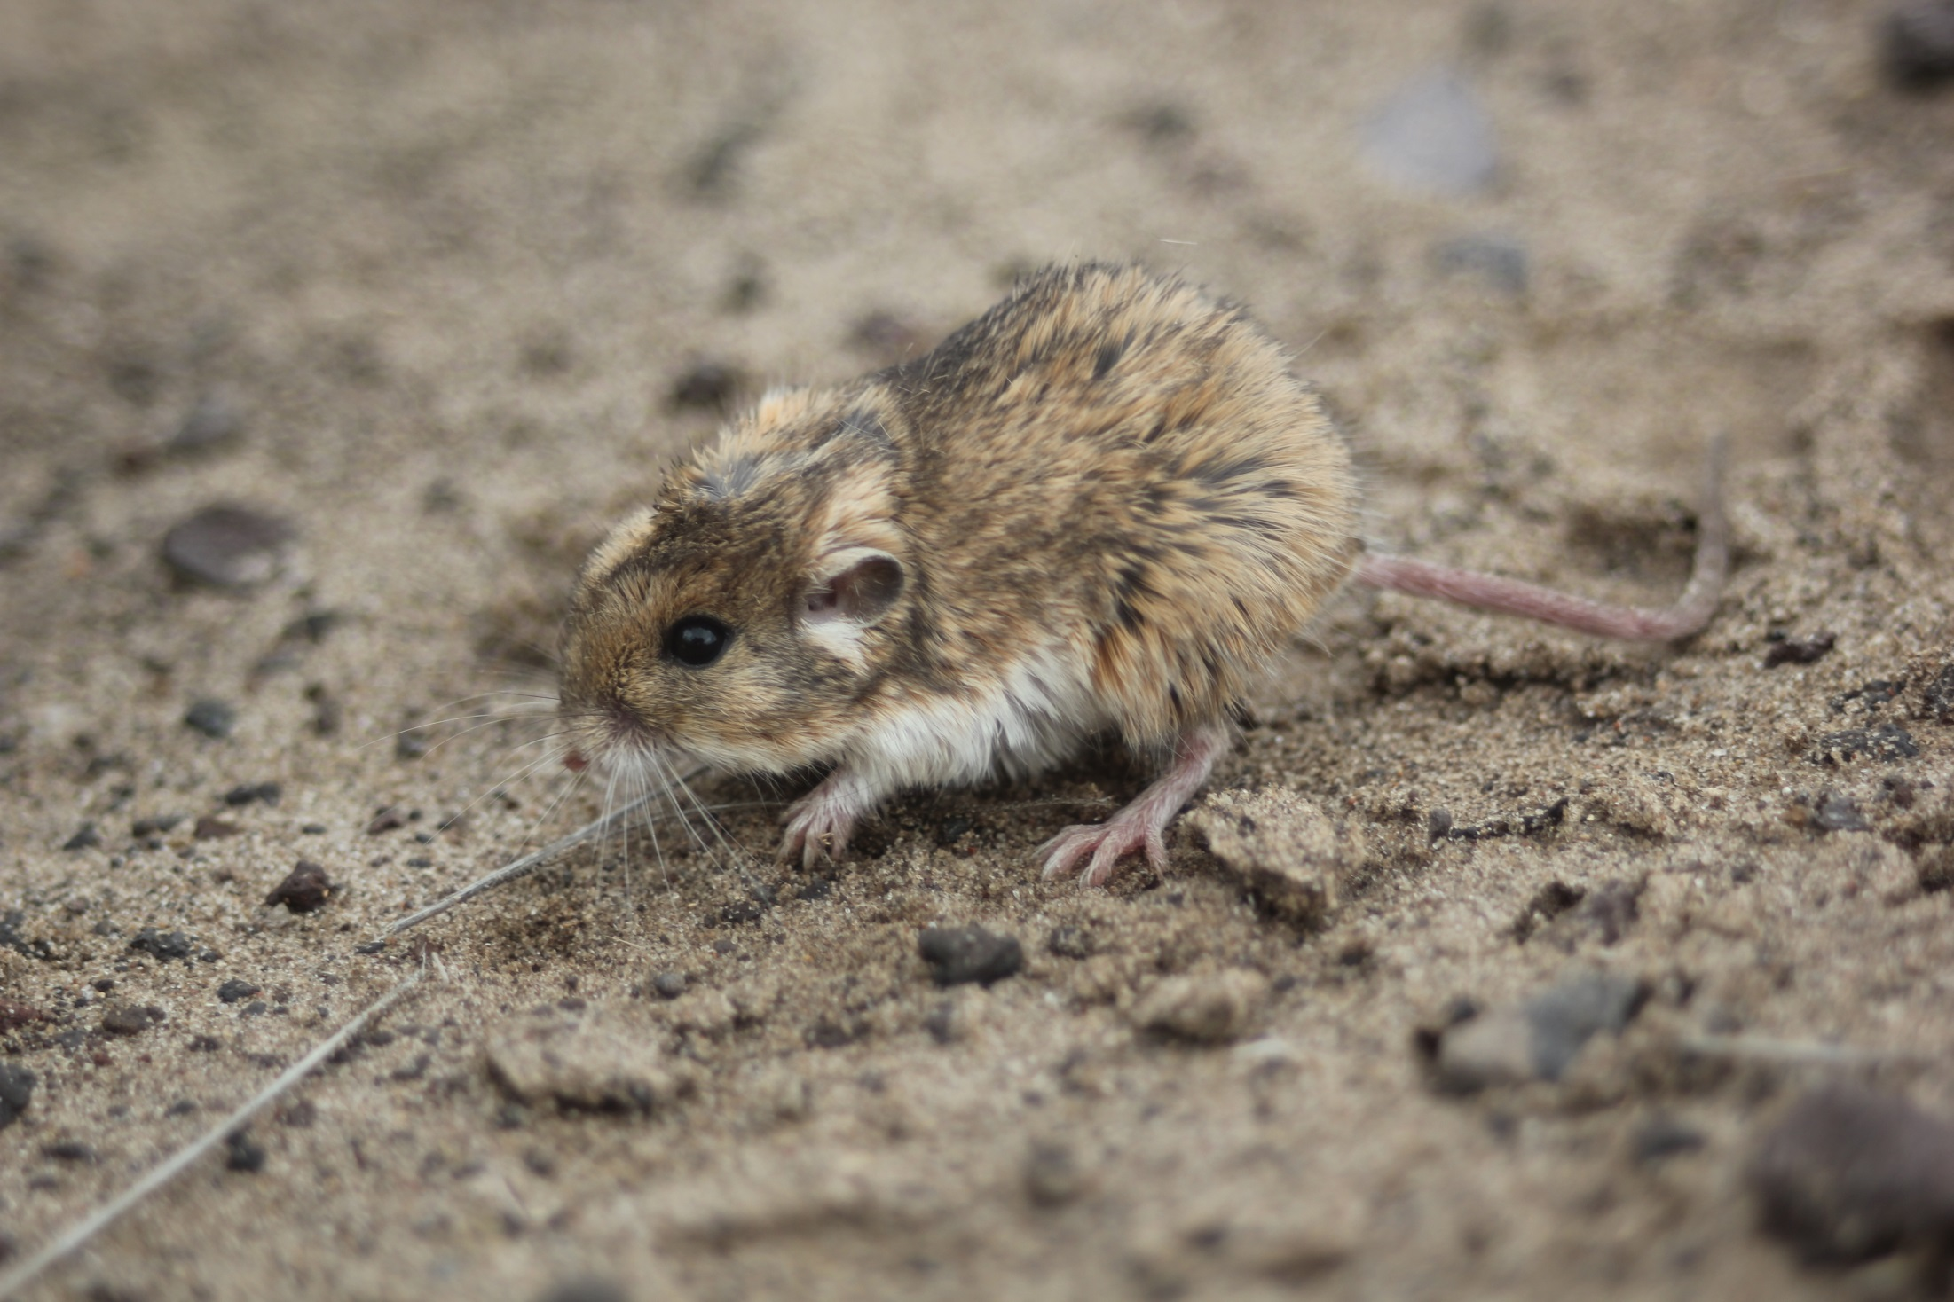
Objectives
Small Mammals
Population size
Diversity
Shrub density and species richness
Grassland Birds
Species richness
Species occupation of burned and unburned areas
Species occupation of ecological sites
Density

Slide 3
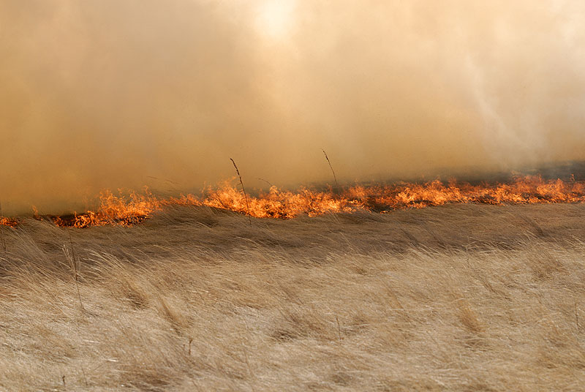
Fire
Past fires were a regular occurrence.
European settlement lead to suppression.
Increased fuel loads on unburned areas have lead to an increased frequency and intensity of fires.
http://www.ericgarland.co/wp-content/uploads/pix/2012/07/grass-fire.jpg

Slide 4
Rock House Fire
April 2011
< 127,000 ha (314,444 ac)
34 days
http://wildfiretoday.com/wp-content/uploads/2011/04/McDonald-Observatory-Hobby-Eberly-Telescope.jpg

Slide 5
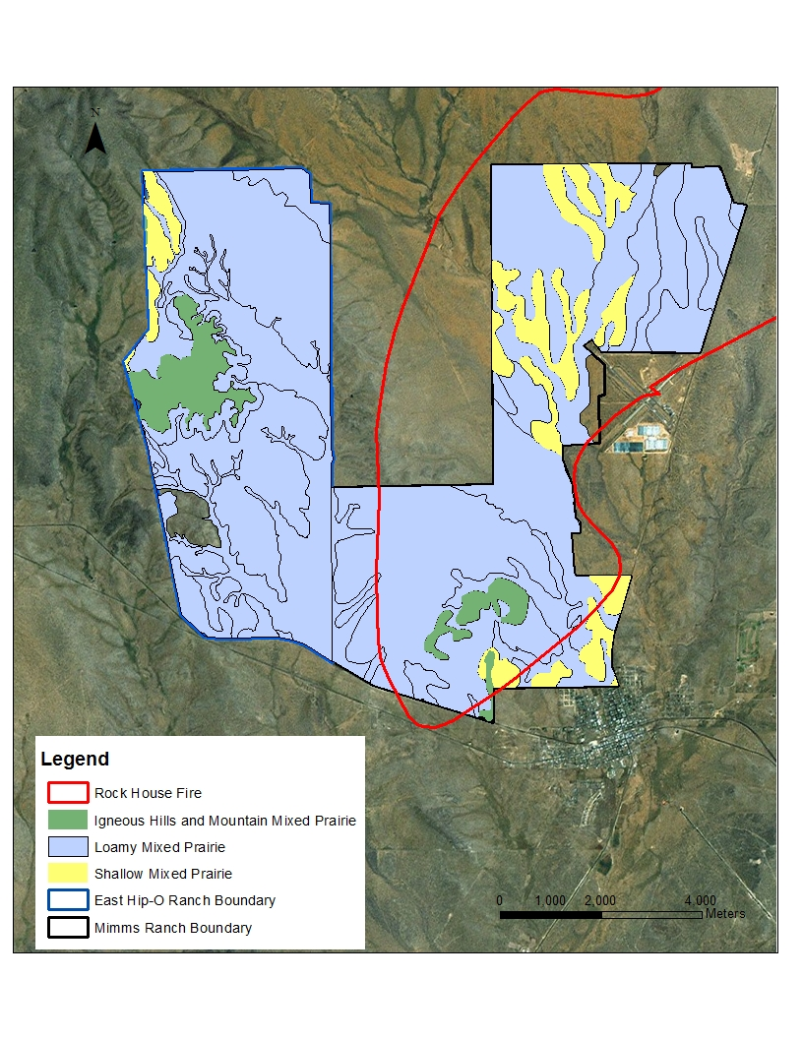
Study Site

Slide 6
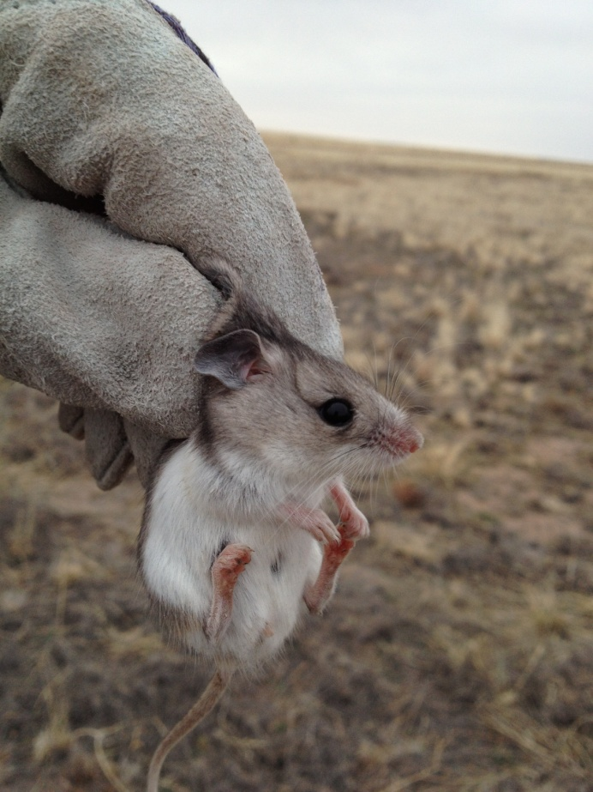
Why
Vegetation Manipulation
Prey base
Disease Vectors
Indicators of Ecosystem Health

Slide 7
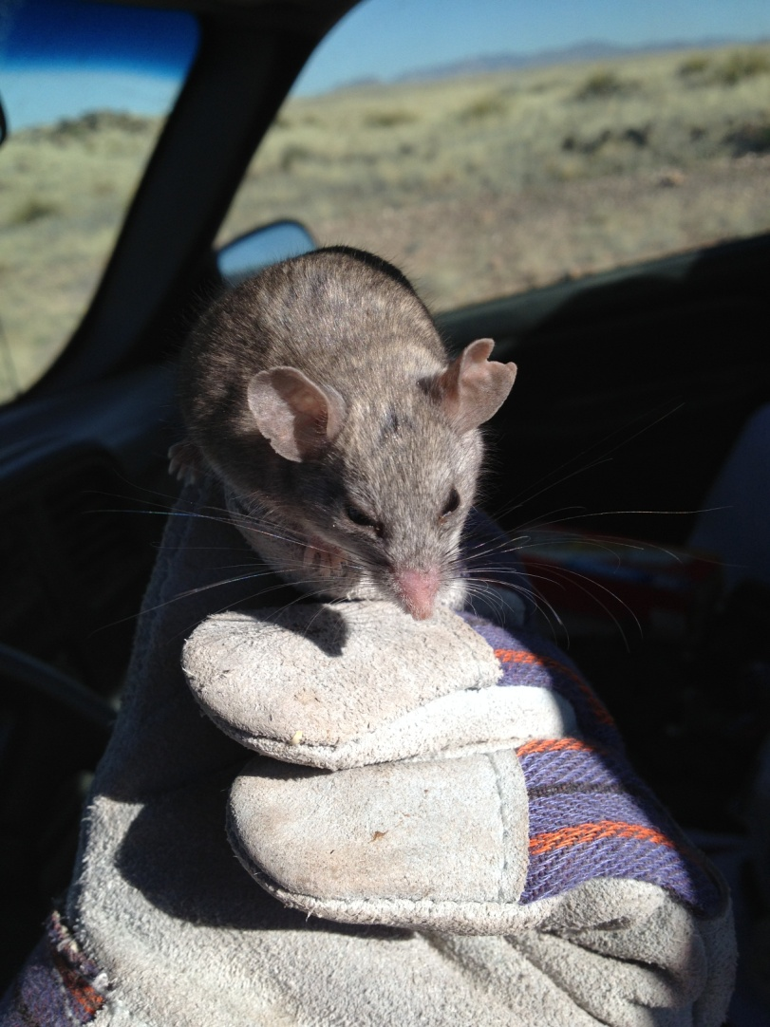
Small Mammal Fire Response
Immediate Decrease
Immigration
Increased Predation
Lack of food
Short gestation and weaning periods

Slide 8
Methods
24 Random sampling points (12 burned, 12 unburned)
4 burned and 4 unburned for each ecological site

Slide 9
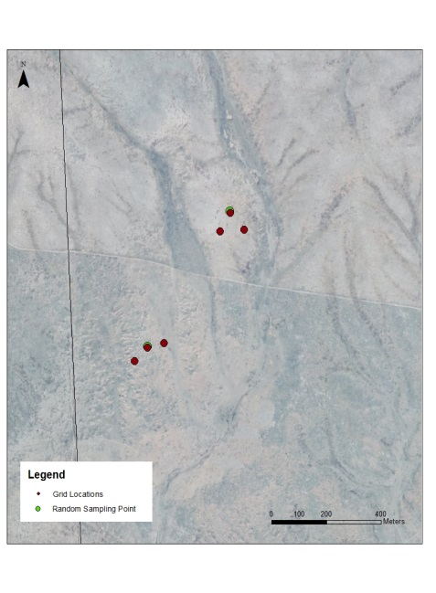
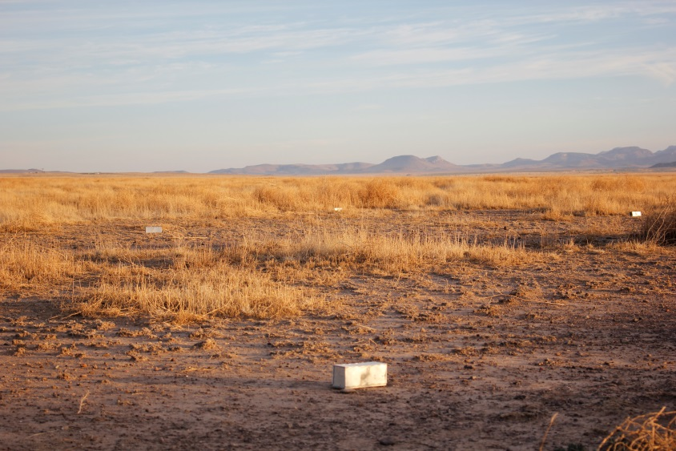
Trapping Layout
3×3 grid (10 m between traps)
Assess shrub density (High, Low, No)
Add two 3×3 grids for remaining shrub density within 100 m

Slide 10
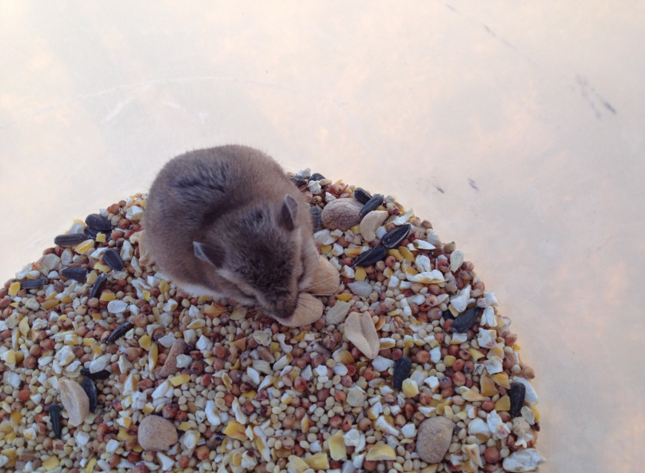
Methods
Sherman live traps (7.6 × 8.9 × 22.9 cm)
Bait: bird seed and peanut mixture
3 seasons
cold dry season (Jan–Mar), warm dry season (May–Jun), and warm wet season (Aug–Sep)
6 consecutive trap nights

Slide 11
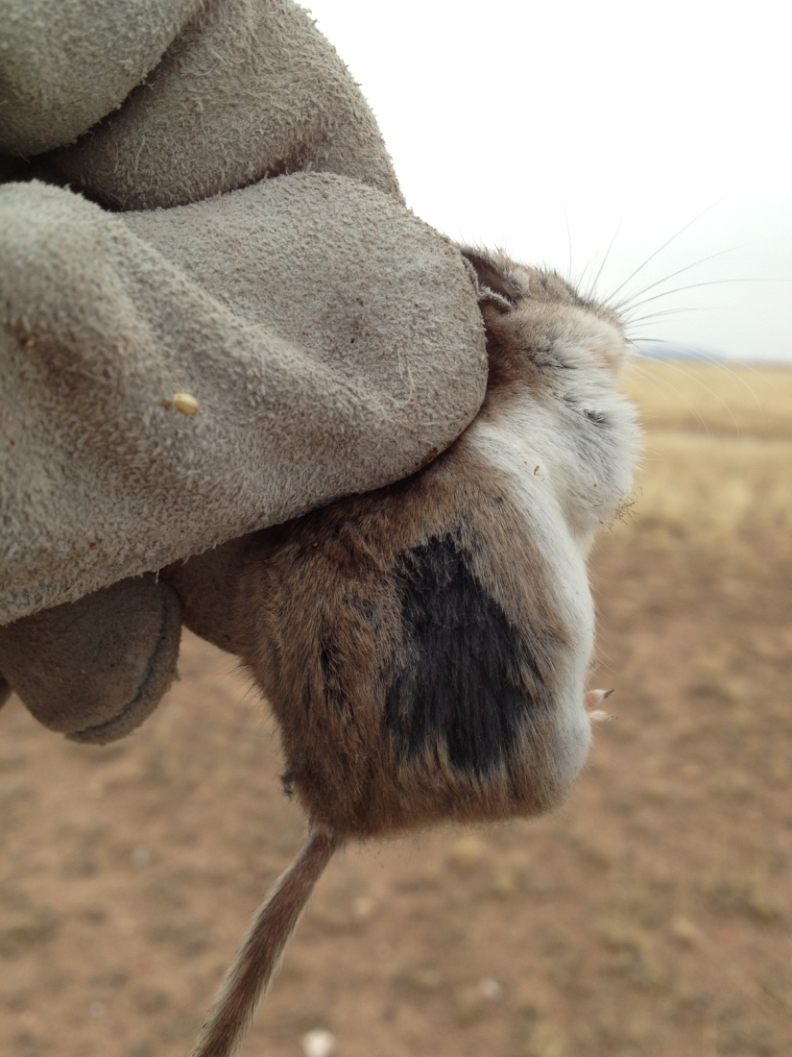
Processing/Analysis
Common measurements
Total length, tail length, hind foot length, ear size, and weight
Species identification
Mark and release
Shumacher-Eschmeyer
2-factor ANOVA
Hutcheson t-test
Poisson Regression

Slide 12
Results

Slide 13
Mean Small Mammal Population Size

Slide 14
Diversity

Slide 15
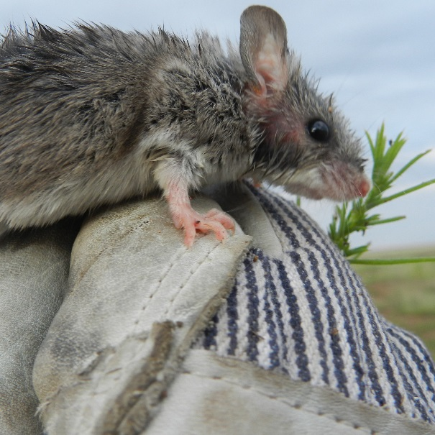
Shrub Density and Species Richness
Positive relationship during 2013 summer (Exp(β) = 2.553, 95% CI [1.194, 5.496], P = 0.016)
Positive relationship during 2014 winter (Exp(β) = 2.553, 95% CI [1.194, 5.456], P = 0.029)

Slide 16
Conclusions
A combination of fire and drought can be detrimental to small mammal populations
Small mammal populations can rebound quickly with precipitation
Diversity takes time
Shrubs might play an important role at different times

Slide 17
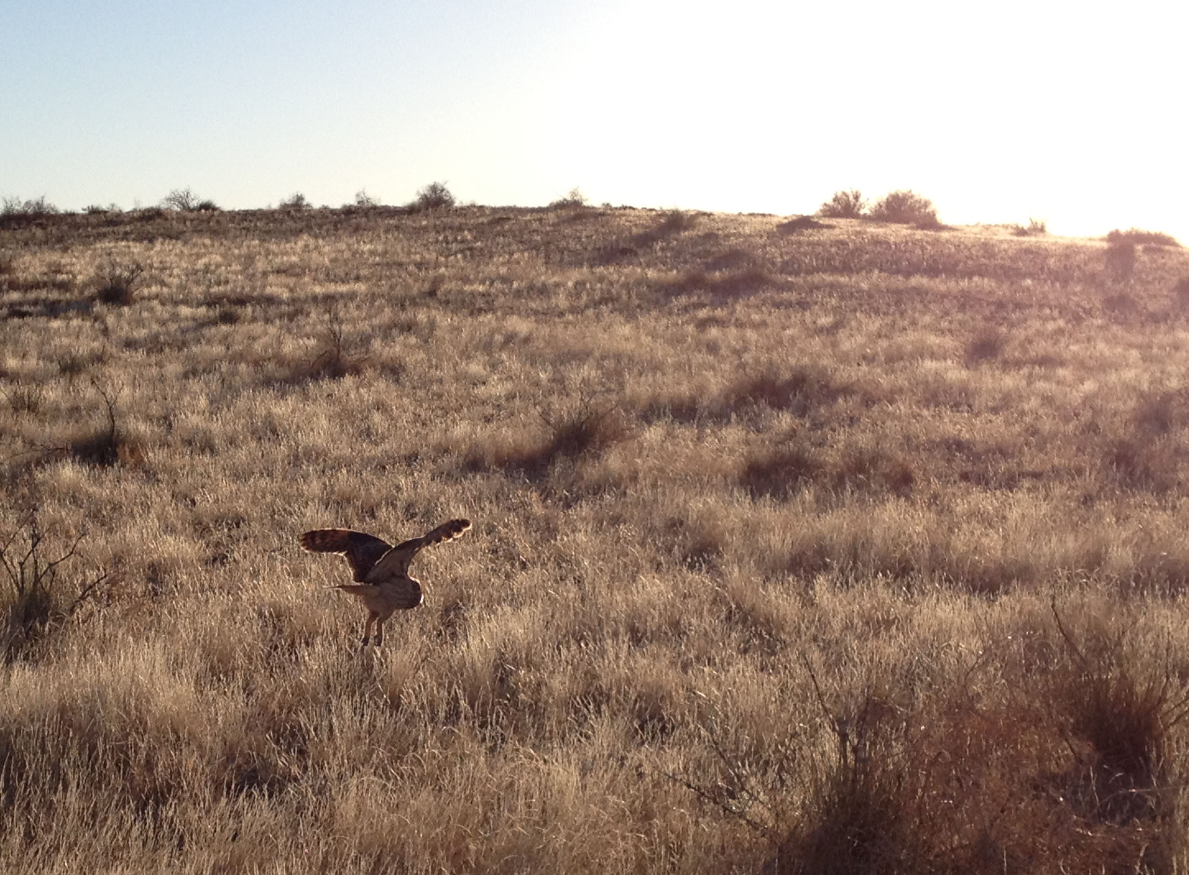
Why
Essential to their environment
Indicator of ecosystem health
Declining populations

Slide 18
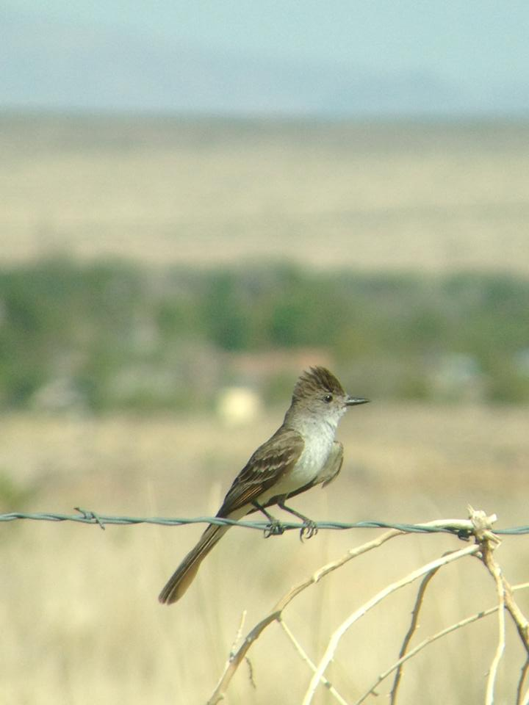
Grassland Bird Response to Fire
Few direct deaths
Immediate decrease
Rebound quickly

Slide 19
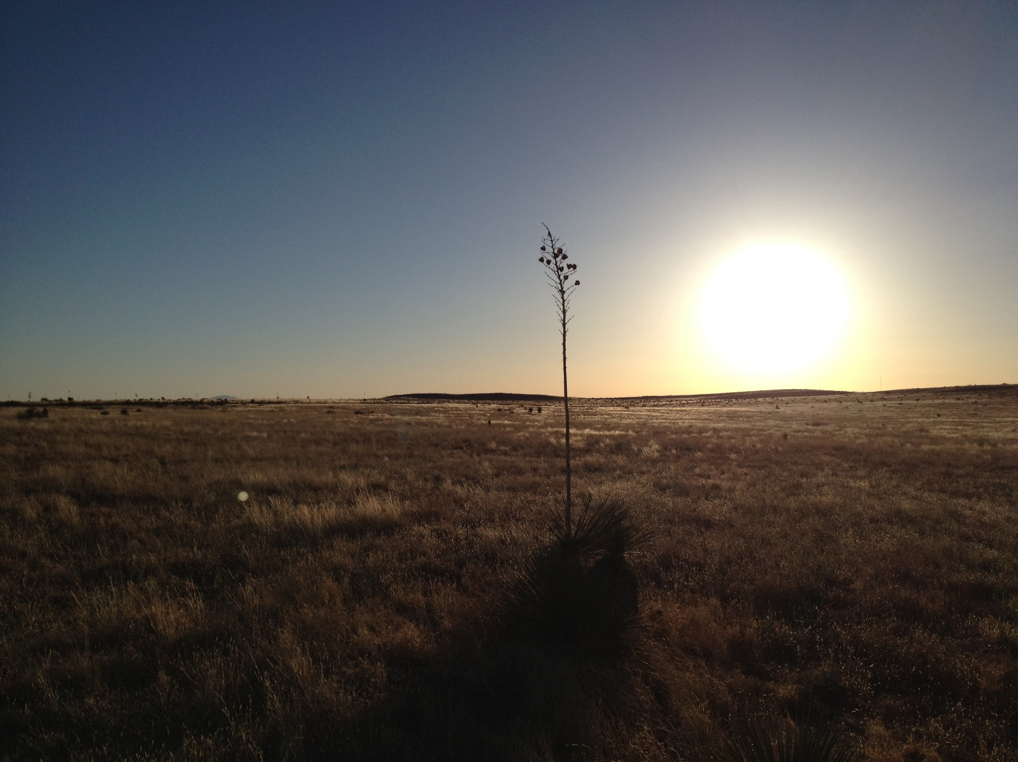
Methods
Point count surveys during summer
24 points
Everything within 100m
Rangefinder for distances
Flushing transects during winter (1km)
12 transects
Rangefinder for distances
GPS for angles

Slide 20
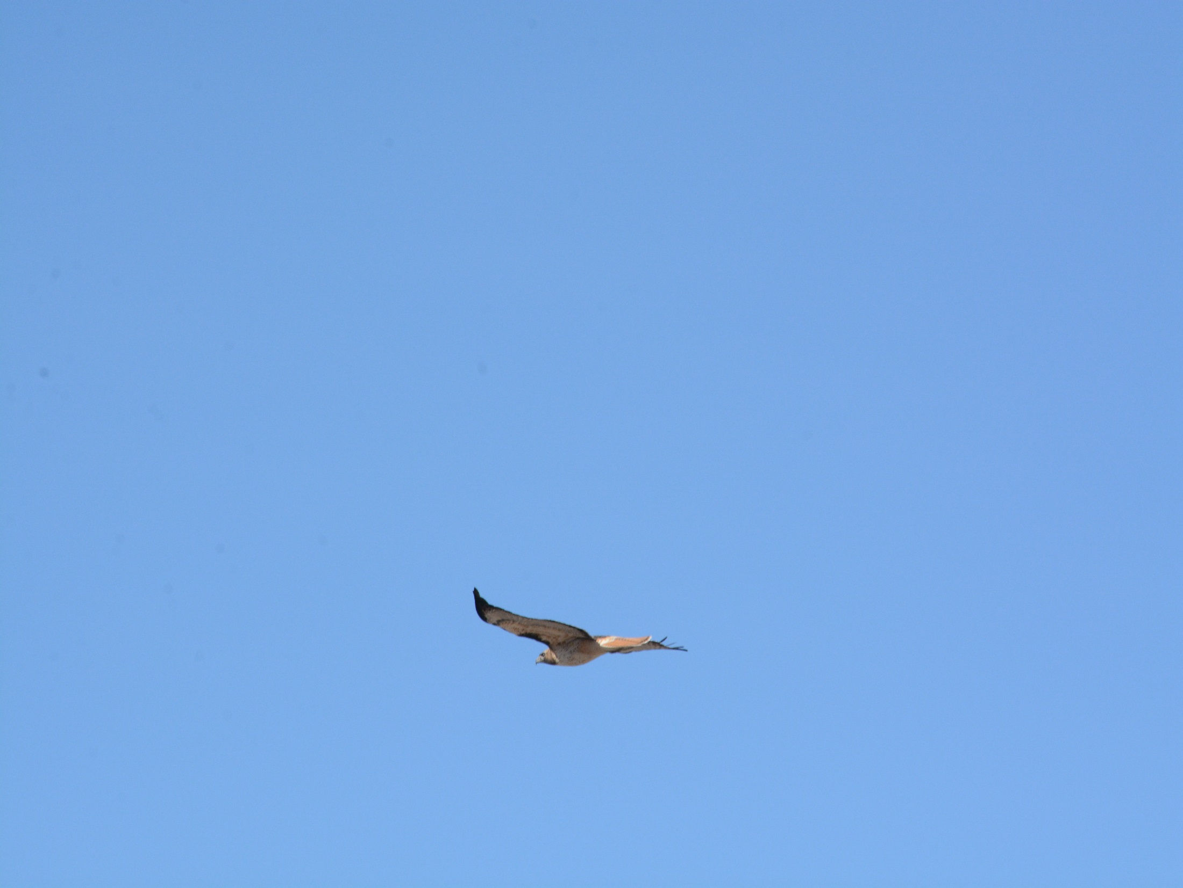
Methods
Richness
Mean number of species
Ecological Site and Burn Status occupation
Chi-square contingency table analysis
Minimum mean expected frequency of 6
Density
Program Distance 6.2
Only for Winter Surveys
Used 100m truncation point
Picked best model based on AICc

Slide 21
Species Richness

Slide 22
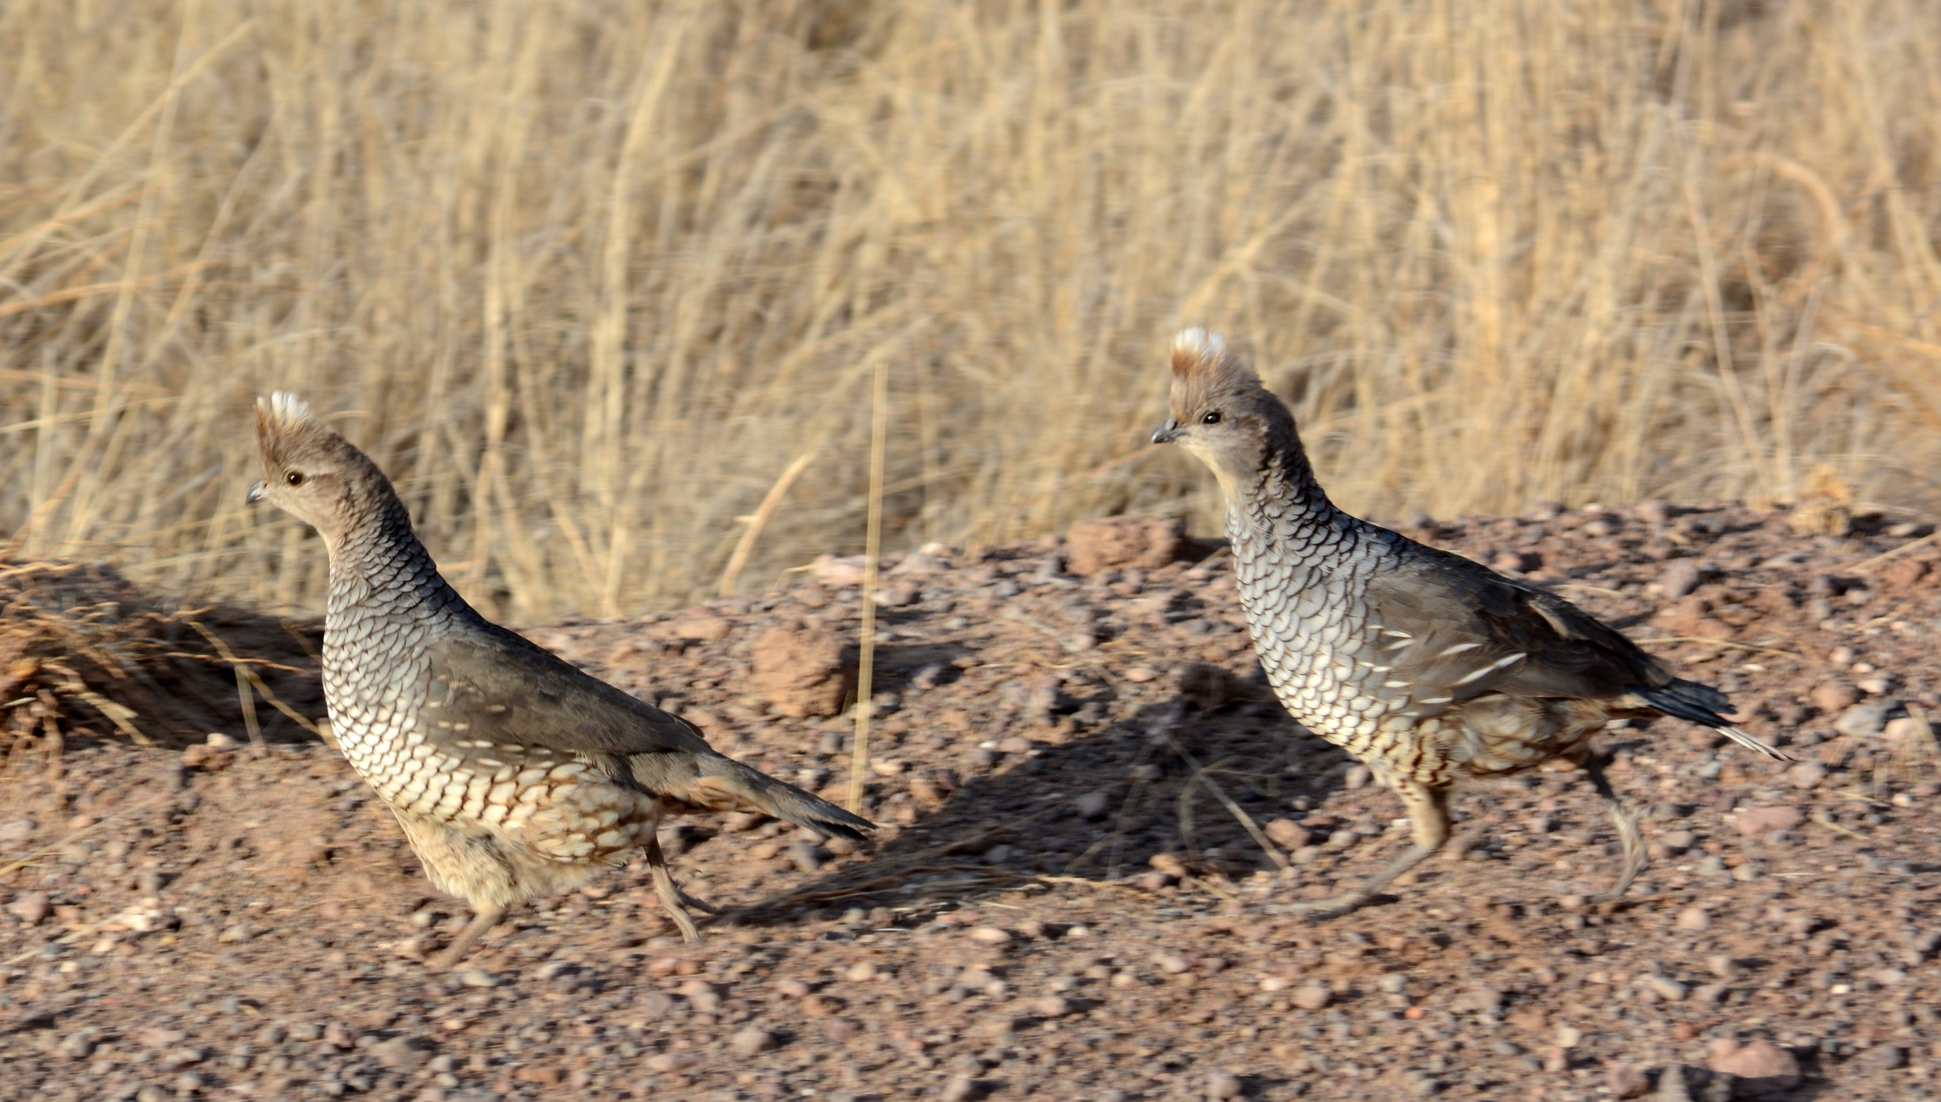
Eco Site and Burn Status
Summer 2013
Burn Status had an effect (P = 0.021)
Summer 2014
Eco Site had an effect (P < 0.001)
Winter 2014
Burn Status and Eco Site had an effect (P < 0.001)
Winter 2015
Eco Site had an effect (P < 0.001)

Slide 23
Density

Slide 24
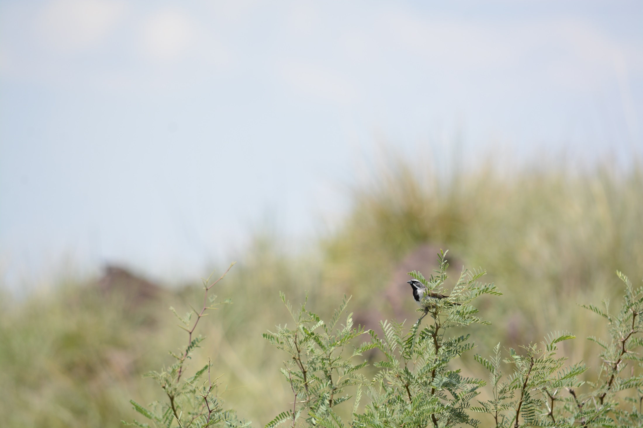
Conclusions
Grassland birds respond quickly
Density still lags behind
Reinforces knowledge of grassland bird populations

Slide 25
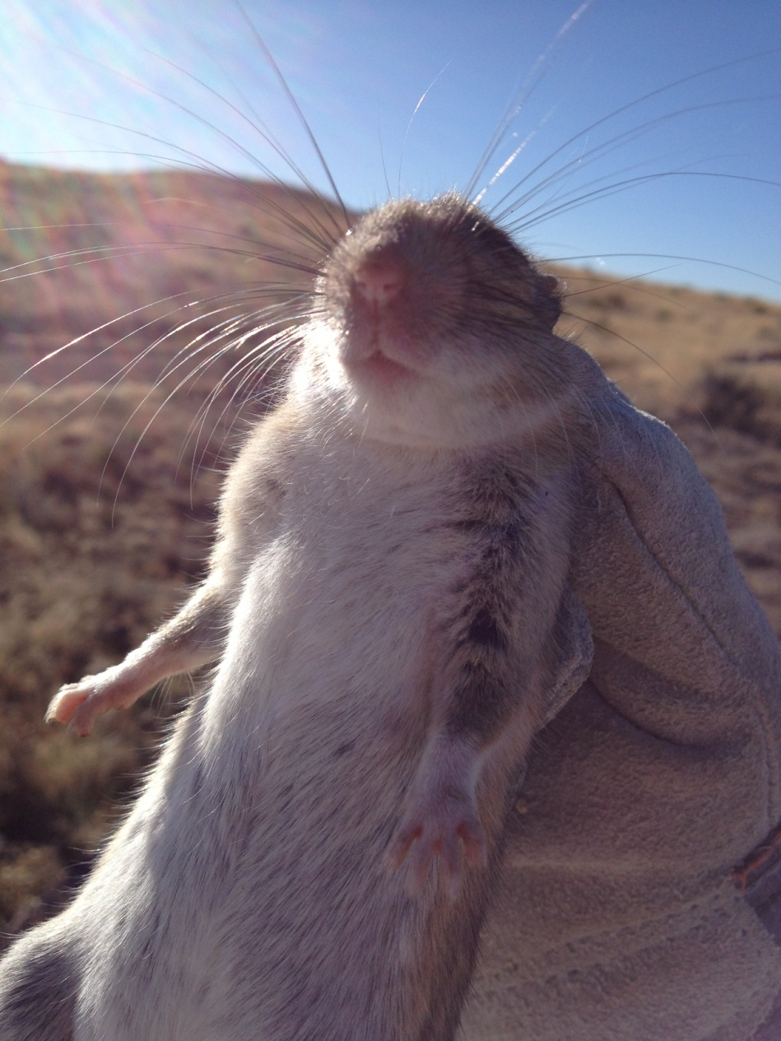
Acknowledgments
God
Committee Members
Sul Ross Faculty
Dixon Water Foundation
East Hip-O Ranch
Houston Safari Club
Borderlands Research Institute
Family
Volunteers/Grad students

Slide 26
Questions?

