Slide 1



INFLUENCE OF FIRE ON AND SUCCESSION OF MICROBIAL COMMUNITIES AFTER DISTURBANCE IN MARFA GRASSLANDS.
MASAHIRO OHNISHI, BONNIE J. WARNOCK,
LOUIS A. HARVESON, JACKIE DENSON

Slide 2
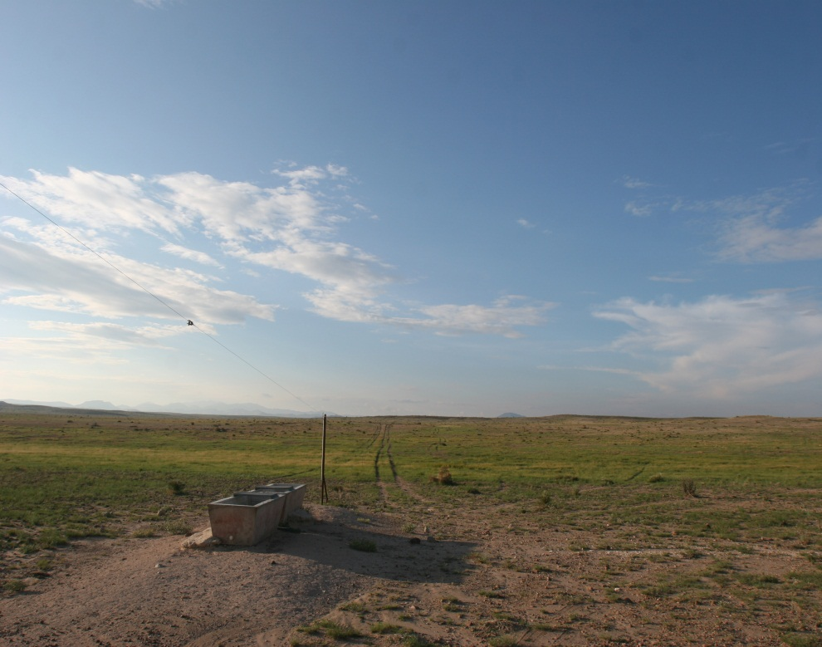
Introduction
About 35% of the western United States is covered by dry land ecosystem (Belnap 2006).
Those areas are utilized as:
Livestock grazing
Agriculture
Energy exploration
Recreation
Urbanization
Other uses
mohn896@sulross.edu

Slide 3
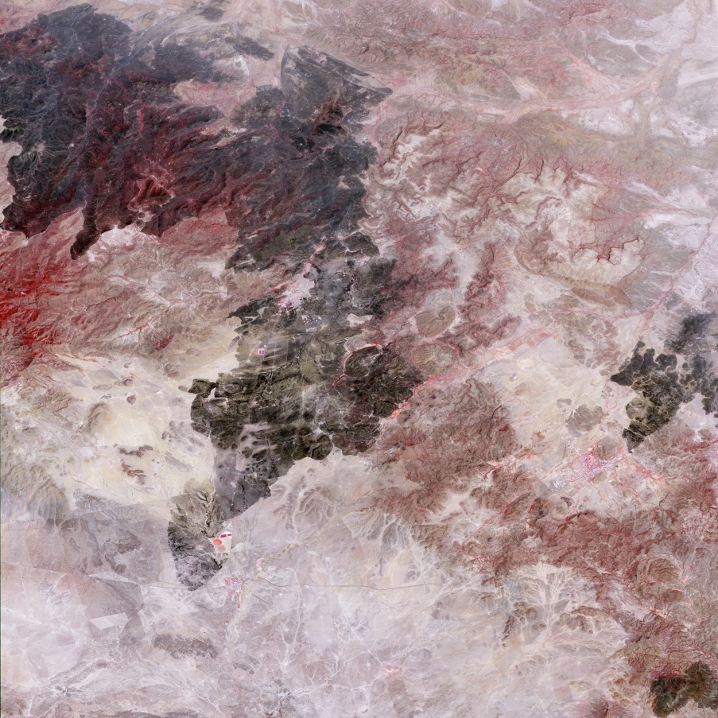
Disturbances : The Rockhouse Fire and Drought, TX 2011
The Rockhouse Fire
- Time: April 9th, 2011
- Location: The Mimms Ranch west of Marfa to the
Davis Mountain (more than 20 miles)
- Covered Areas: 314,444 acres
The Exceptional Drought
- Time: January 2011 to May 2012
- Precipitation: 18.6 cm (7.31 inches) for 17 months
(John Edwards and ncdc.noaa.gov)
Mimms Ranch
<http://earthobservatory.nasa.gov/NaturalHazards/view.php?id=50431>
mohn896@sulross.edu

Slide 4
Study area: the Mimms Ranch (Ecological Sites)
- Loamy Mixed Prairie
(Green)
- Shallow Mixed Prairie
(Blue)
- Igneous Hills and Mt. Mixed Prairie
(Brown)
- Elevation ranges
1,371.6 ~ 1,981.2 m
- Average annual precipitation
40.1 cm (16.1 inches)
mohn896@sulross.edu

Slide 5
Study area: the Mimms Ranch (Soil Series & Seasons)
Soil Series
- Hippo-Fomile complex
(Loamy Mixed Prairie)
- 3 burned areas
- 3 unburned trampled areas
- 3 unburned areas
Seasons
- Early Summer (June, 2012)
- Late Summer (September, 2012)
mohn896@sulross.edu

Slide 6
Objectives:
Analyze the diversity of microflora of the soil surface in
burned, unburned trampled, and unburned areas.
2) Evaluate mechanisms of recovery and growth of the
microflora and herbaceous plants of the soil surface in
the Marfa Grasslands.
mohn896@sulross.edu

Slide 7
Methods: Microbes (Bacteria & Archaea)
■ 50 grams of soil was collected into 50 ml Polypropylene conical
tubes and kept in a cool environment.
● DNA Extraction
- MoBio PowerSoil DNA Isolation Kit (Catalog # 12888-50)
● DNA Concentration (A260/A230 and A260/A280)
- GE NanoVue spectrophotometer
mohn896@sulross.edu

Slide 8
Methods: Microbes (Bacteria & Archaea)
● Quantitative Polymerase Chain Reaction (qPCR)
- Bio-Rad icycler (MyiQ Single Color Real-Time PCR Detection System)
- Fast EvaGreen qPCR master mix (Catalog #31003-1)
- Primer Sets
Gene | Pathway | Gene | Pathway
Bacteria 16S | 16S rRNA | nifH | Nitrogen fixation
Archaea 16S | 16S rRNA | nirK | Nitrite reduction
amoA (bacteria) | Ammonia oxidation | Cel48 | Family 48 glycoside hydrolase
amoA (archaea) | Ammonia oxidation | mcrA | Methanogenesis
dsrAB | Sulfate reduction
mohn896@sulross.edu

Slide 9
Methods: Soils
■ One hundred grams of soil from each study site
- all soil are collected from top 2 cm
- air drying of soil samples
● pH
● Water Holding Capacity (DewPointmeter)
● Particle Size Distribution
● Salinity
● Major chemical elements in the soil samples:
- Ammonium (NH4+), Nitrates (NO3-),
Potassium (K), Phosphorous (P), Sodium (N), Magnesium (Mg),
Calcium (Ca), Iron (Fe), Copper (Cu), and Boron (B)
mohn896@sulross.edu

Slide 10
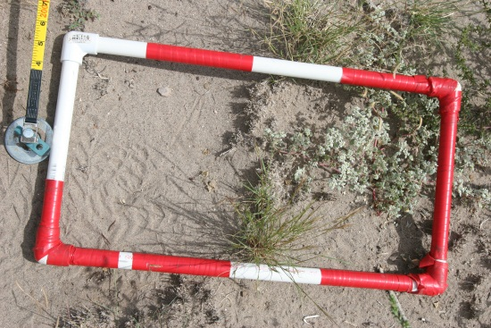
Methods: Vegetation
■ ⅛ m² Daubenmire Quadrat
- 50 m transect with 11 quadrats
per transect
● Canopy Cover
- Mean Grasses & Forbs with Confidence Limits
● Basal Cover
- Mean Grasses & Forbs with Confidence Limits
● Relative Frequency
- Grasses & Forbs
mohn896@sulross.edu

Slide 11
Statistical Analysis:
● Pearson’s Correlation
To extract appropriate variables in order to run
the Linear Regression
● Linear Regression
To Observe the relationships between microbial
biomass and other factors
mohn896@sulross.edu

Slide 12
Results: Microbial Activities
(Objective 1= Analysis of the diversity of microflora)
TABLE 1. Mean of pH
Early Summer Late Summer
Burned Area 7.62 7.4
Trampled Area 6.69 6.18
Unburned Area 6.64 6.62
TABLE 2. Measure of Biomass (DNA mg/g of soil)
Early Summer Normalized Late Summer Normalized
Burned Area 1.96 (mg/g) 53% 3.54 (mg/g) 54%
Trampled Area 3.38 (mg/g) 91% 5.14 (mg/g) 78%
Unburned Area 3.7 (mg/g) 100% 6.6 (mg/g) 100%
TABLE 3. Mean of Cycle Threshold (Ct) Values from qPCR
Gene | Pathway | Early Burned | Early Trampled | Early Unburned | Late Burned | Late Trampled | Late Unburned
Bacteria 16S | 16S rRNA | 15.35 | 14.8 | 14.84 | 15.435 | 14.45 | 14.76
Archaea 16S | 16S rRNA | 24.18 | 22.805 | 22.06 | 22.265 | 22.615 | 23.45
amoA (bacteria) | Ammonia oxidation | 43.195 | 37.97 | 37.345 | 38.665 | 37.37 | 38.08
amoA (archaea) | Ammonia oxidation | 33.36 | 26.25 | 24.625 | 25.725 | 24.96 | 24.23
dsrAB | Sulfate reduction | 39.27 | 33.82 | 31.03 | 30.32 | 30.68 | 30.22
nifH | Nitrogen fixation | 23.93 | 24.385 | 24.285 | 23.795 | 22.01 | 23.89
nirK | Nitrite reduction | 25.495 | 23.76 | 23.305 | 22.915 | 22.84 | 22.84
Cel48 | Family 48 glycoside hydrolase | 33.075 | 34.905 | 33.135 | 33.055 | 34.305 | 36.64
mcrA | Methanogenesis | 36.38 | 29.34 | 29.18 | 29.905 | 28.14 | 27.75
mohn896@sulross.edu

Slide 13
Results: Chemical Elements in the Soil
(Objective 2: Evaluate mechanisms of recovery and growth of the microflora and herbaceous plants)
FIG 1. NO3-N significantly decreased after monsoon season.
FIG 2. Nitrogen Cycle
Atmospheric Nitrogen (N2)
Plants
Decomposers: Bacteria & Fungi
Ammonia (NH4+)
Nitrites
(NO2-)
Nitrates
(NO3-)
Early Summer
Late Summer
mohn896@sulross.edu

Slide 14
Results: Chemical Elements in the Soil
(Object 2: Evaluate mechanisms of recovery and growth of the microflora and herbaceous plants)
FIG 3. Potassium in burned area was lower than other unburned areas.
mohn896@sulross.edu

Slide 15
Results: Vegetation (Basal Cover)
(Objective 2: Evaluate mechanisms of recovery and growth of the microflora and herbaceous plants)
FIG 4. Early & Late Summer 2012: Mean Grasses & Forbs of Basal Cover with Confidece Limits
mohn896@sulross.edu

Slide 16
Results: Vegetation (Canopy Cover)
(Objective 2: Evaluate mechanisms of recovery and growth of the microflora and herbaceous plants)
FIG 5. Early & Late Summer 2012: Mean Grasses & Forbs of Canopy Cover with Confidence Limits
mohn896@sulross.edu

Slide 17
Results: Vegetation (Relative Frequency)
(Objective 2: Evaluate mechanisms of recovery and growth of the microflora and herbaceous plants)
FIG 6. Early & Late Summer 2012: Mean Grasses & Forbs of Relative Frequency
mohn896@sulross.edu

Slide 18
Results: Statistical Analysis (Linear Regression)
Model Summary
Dependent Variable: DNA Biomass
Independent Variables: pH, NO3-N, Basal Cover PG&PF&AF
FIG 7. Linear Regression showed that there is strong correlations between DNA Biomass
and other independent variables.
Model R R Square Adjusted R Square F Sig.
1 .977 .954 .935 49.764 .000
Regression Equation
Y = 19.351+{(-0.253)X1+4.695X2+(0.309)X3+(-11.084)X4+(-13.2)X5}
mohn896@sulross.edu

Slide 19
Conclusion & Discussion:
Microbes recovered significantly after monsoon.
Nitrates (NO3-) were produced by nitrifying bacteria and taken by plants.
Microbial activities are one
of the important function in
the dry land ecosystems.
Grasses and forbs came back significantly by taking nutrients during the monsoon.
Microbes could be an indicator for the rangeland health assessment after fire or drought.
mohn896@sulross.edu

Slide 20
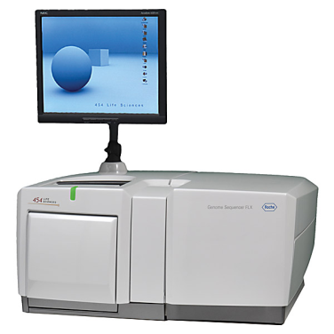
Further Study: Microbial Diversity
● Roche 454 Amplicon Sequences
- emPCR
- Lib-L kit (Unidirectional Sequencing)
- 5000 reads
<http://454.com/products/gs-flx-system/index.asp>
mohn896@sulross.edu

Slide 21
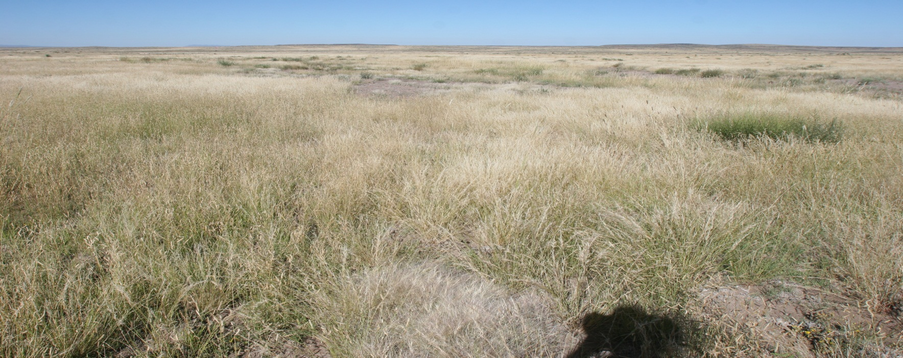
Acknowledgements:
Bonnie J. Warnock, Borderlands Research Institute, Department of Natural Resource Management, Sul Ross State University Alpine, TX 79832, USA
Louis A. Harveson, Borderlands Research Institute, Department of Natural Resource Management, Sul Ross State University Alpine, TX 79832, USA
Jackie Denson, Department of Biology, Sul Ross State University Alpine, TX 79832, USA
Dixon Water Foundation, West Texas Office P. O. Box 177 Marfa, TX 79843, USA
My wife (Nora), my family (in Japan), friends, graduate students, and under graduate students.
Thank You!
mohn896@sulross.edu

